Slide 1
Preparations for the Testing of ITk Silicon Strip Sensors
Andrew Musgrave

Slide 2
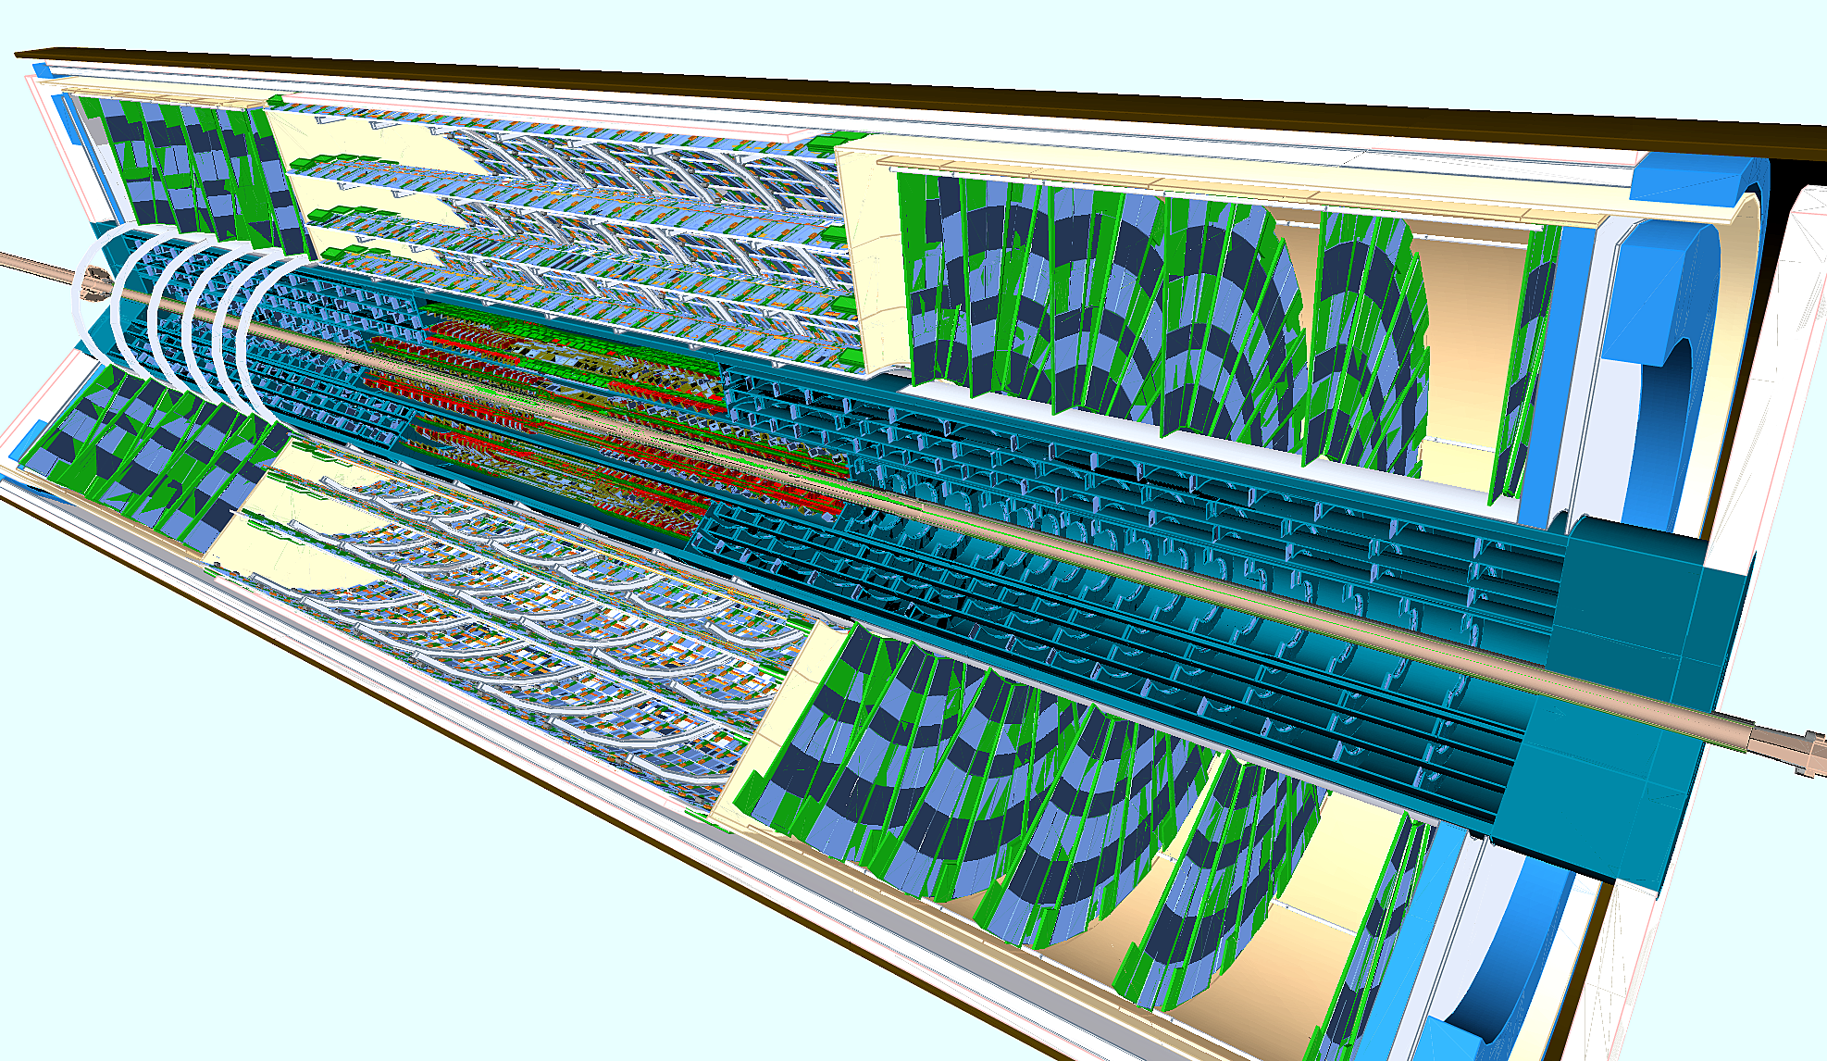
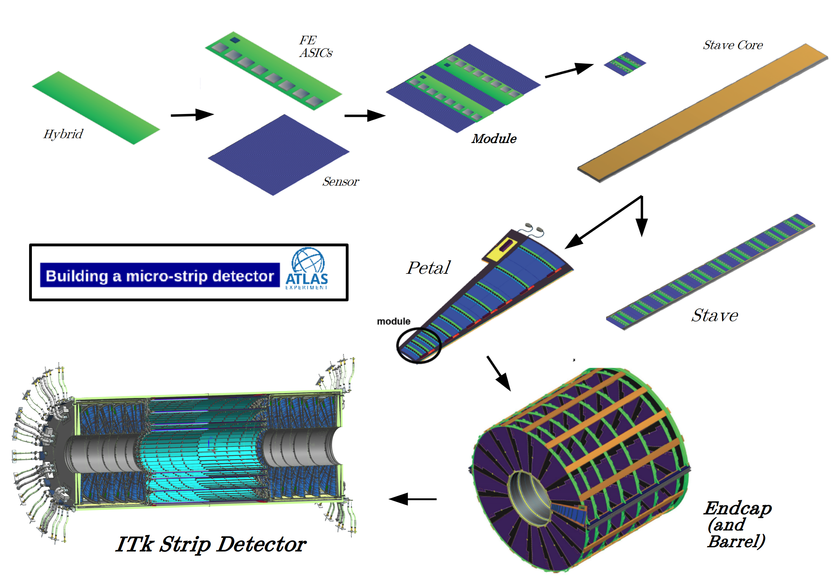
Inner Tracking Detector
The inner tracking detector is a large area silicon sensor
It must have full coverage (hermeticity)
It consists of pixel detectors on the inner layers and strip detectors on the outer layers

Slide 3
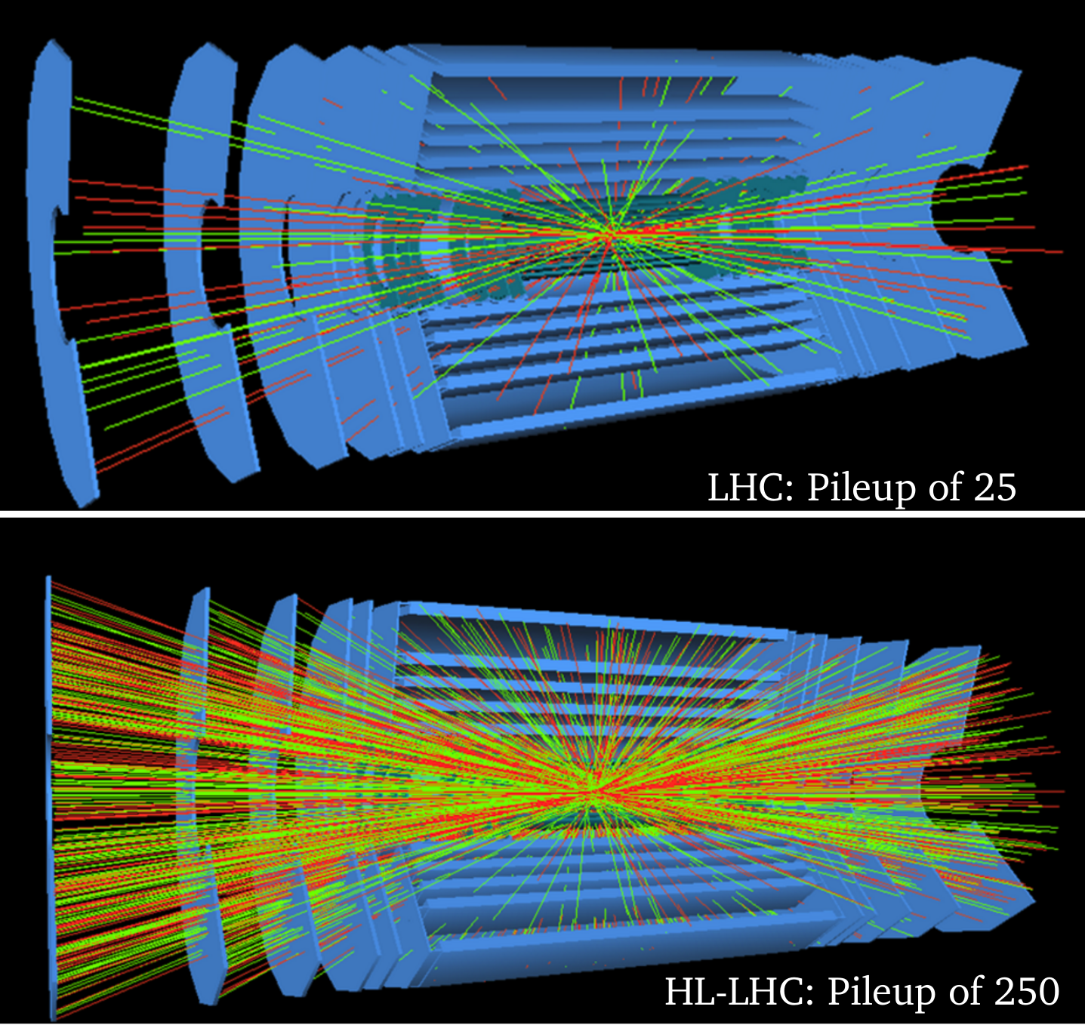
The High Luminosity LHC
The HL-LHC will increase luminosity from 1x 10³⁴ cm⁻²s⁻¹ to 7.5 x 10³⁴ cm⁻²s⁻¹
The total dataset will be increased by an order of magnitude
Installation will take place in 2024-2026

Slide 4
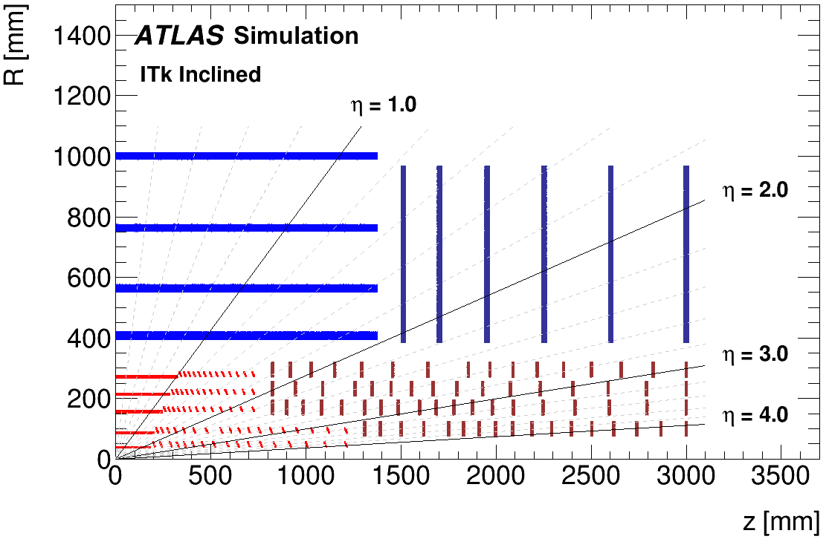
Track Reconstruction
Each time an ionizing particle passes through a detector layer a vertex is recorded
The sensors on each side of a layer are angled relative to each other
A sophisticated algorithm is used to reconstruct the particle tracks from these vertices

Slide 5
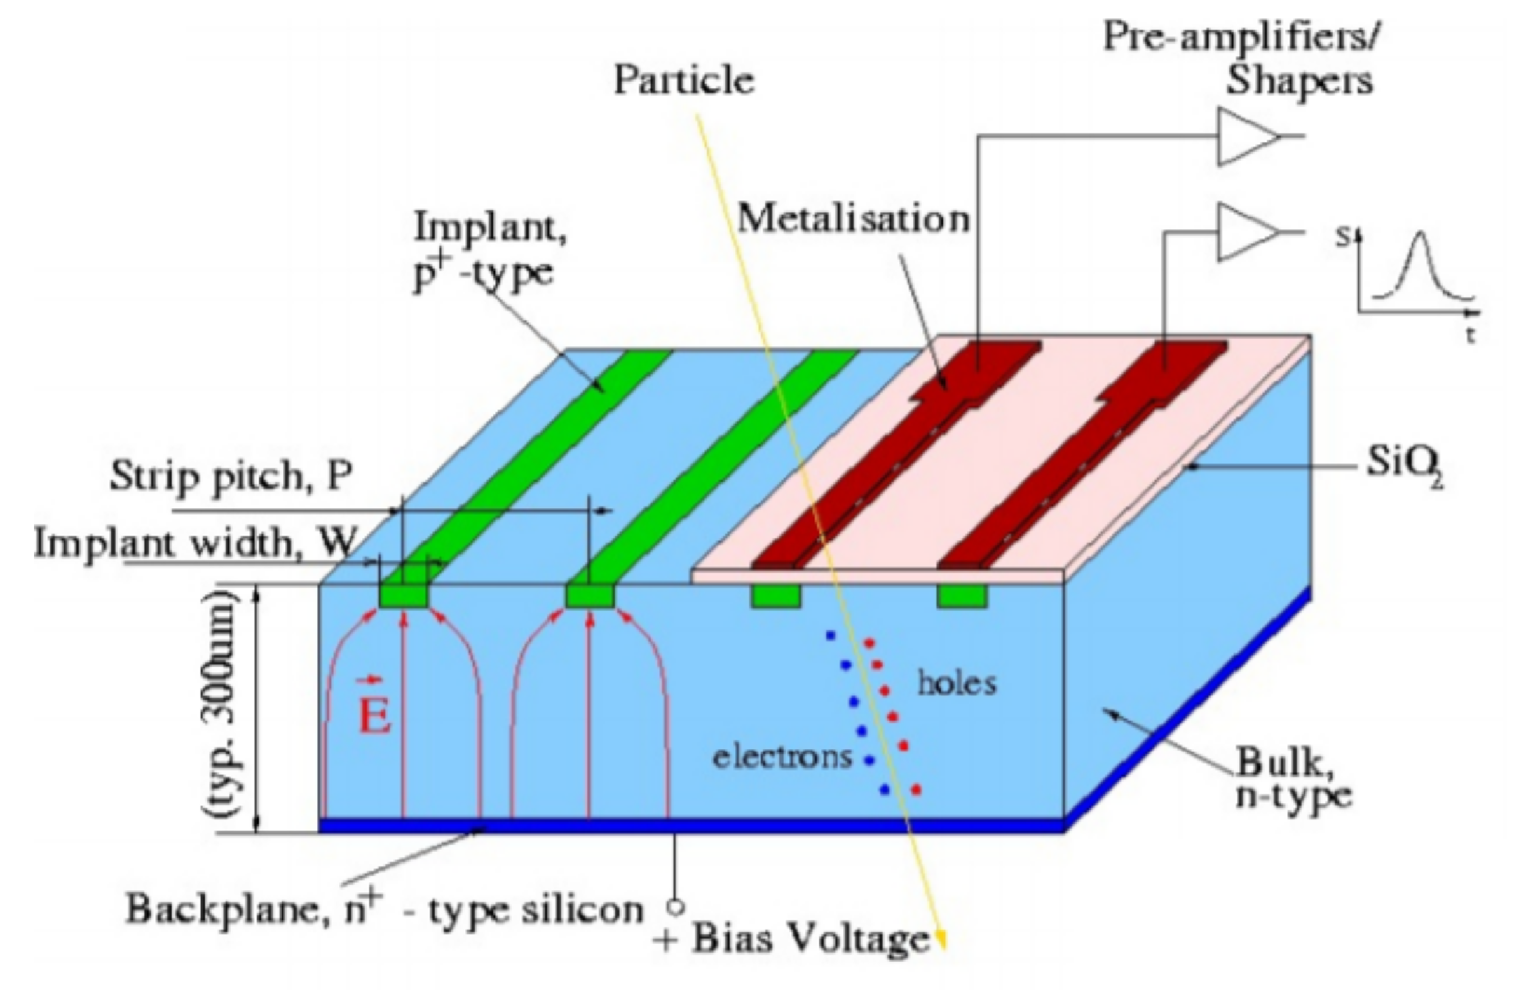
Silicon Strip Detector
Consists of n+ implants in a p substrate
The implants are AC coupled to aluminum strips
Held in reverse bias of up to 700V
An ionizing particle passing through the detector frees charge carriers and induces a voltage spike in the sensor strip

Slide 6
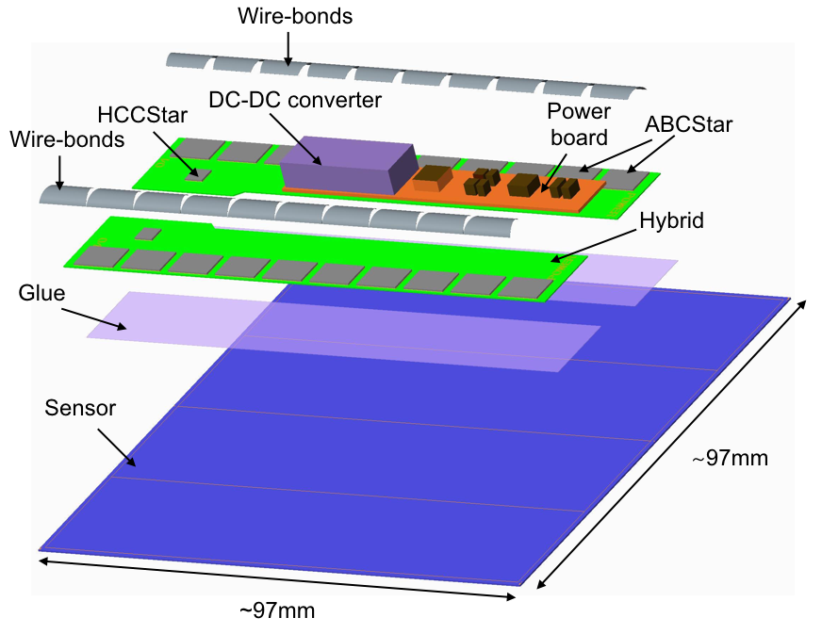
Readout Chips
ABC130 or ABC* chips are used to gather data from the strip sensors
Each ABC receives input from 256 strips
The ABC is responsible for digitizing data and managing readout

Slide 7
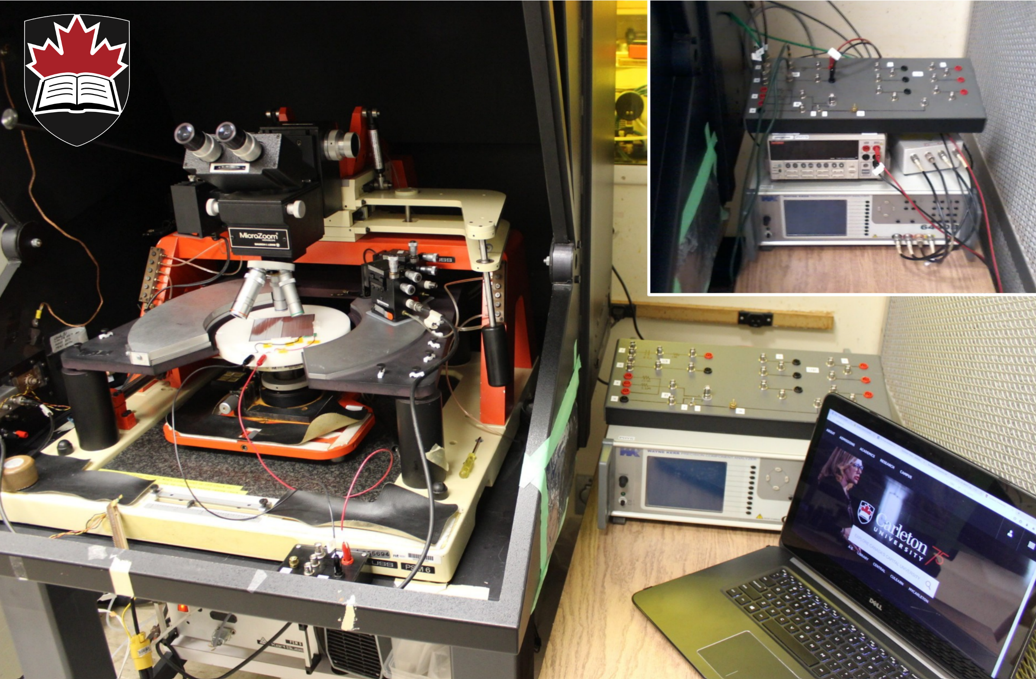
Sensor Testing at Carleton
5000 sensors will pass through Carleton by the end of 2023
Visual inspection
Basic metrology: sensor flatness
Leakage Current: IV curve
Full depletion voltage: CV curve

Slide 8
Environmental Monitoring
A Raspberry Pi is used to monitor the conditions in the Clean Room
I maintained this system and implemented a database to record and manage environmental data

Slide 9
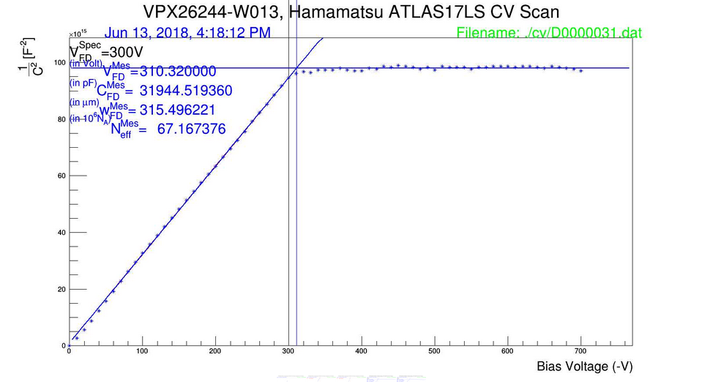
Sensor Measurements
I assisted in measuring the IV and CV curves for a pair of sensors
Breakdown voltage and full depletion voltage were observed

Slide 10
Analog Test Code
Analog tests of the ABC130 produce long and unreadable output files
Root scripts are used to parse this output and produce plots

Slide 11
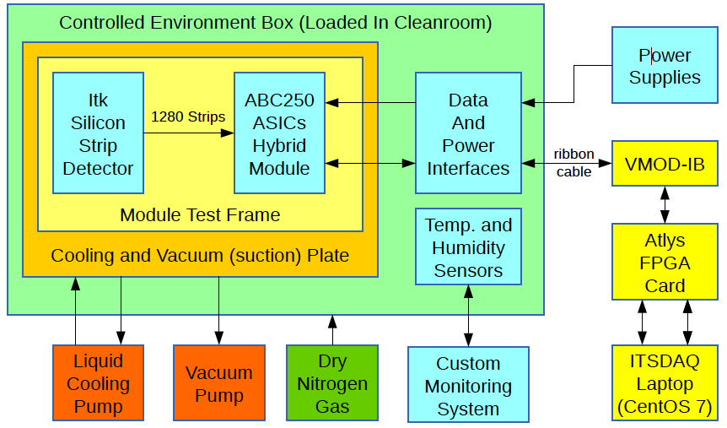
ITSDAQ Installation
ITSDAQ is the data acquisition software for the ABC130 and ABC*
It was installed on the clean room computer for use with the single chip tester

Slide 12
A Learning Experience
Through this opportunity I have learned many things, including:
How to use the ROOT data analysis framework
How to work in a clean room environment
A great deal about silicon tracking detectors!

