Slide 1
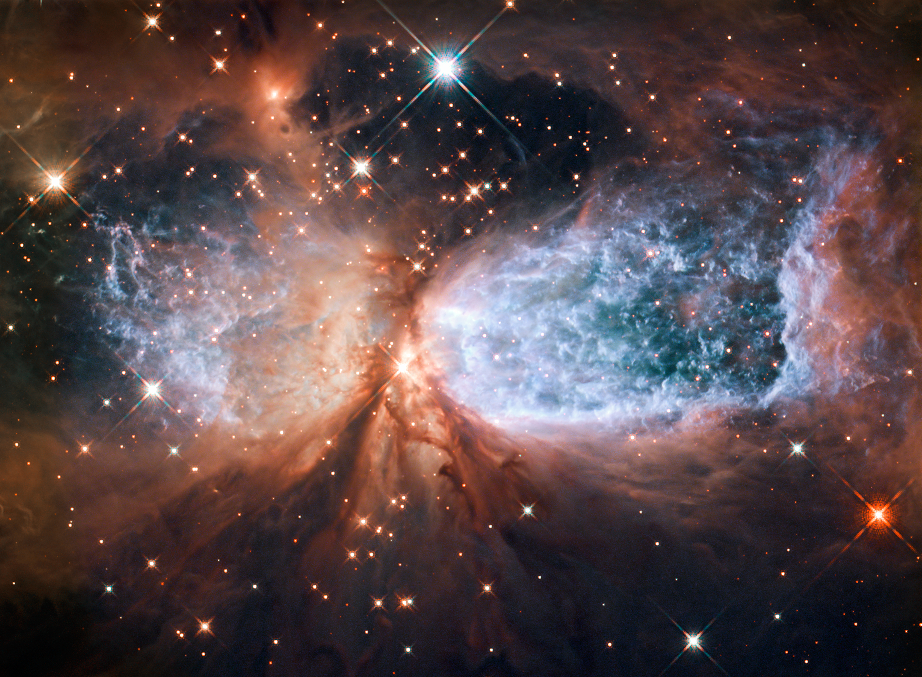
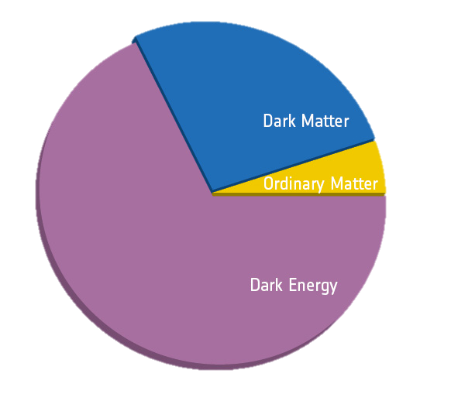
Where is the Dark Matter?
Waqar Muhammad
DEAP-3600 Collaboration
Carleton Physics Department
September 18th 2018

Slide 2
Where is the Dark Matter?
Waqar Muhammad
DEAP-3600 Collaboration
Carleton Physics Department
August 17th 2018
What is the universe made up of?
Ordinary matter only accounts for 4.9% of all the energy density in the universe [1]
When studying large astronomical objects Dark Matter was found to make up 26.8% of the energy density
The rest is made up of Dark Energy
26.8%
4.9%
68.3%
[1] P. A. R. Ade et al. (Planck), Astron. Astrophys. 594, A13 (2016)

Slide 3
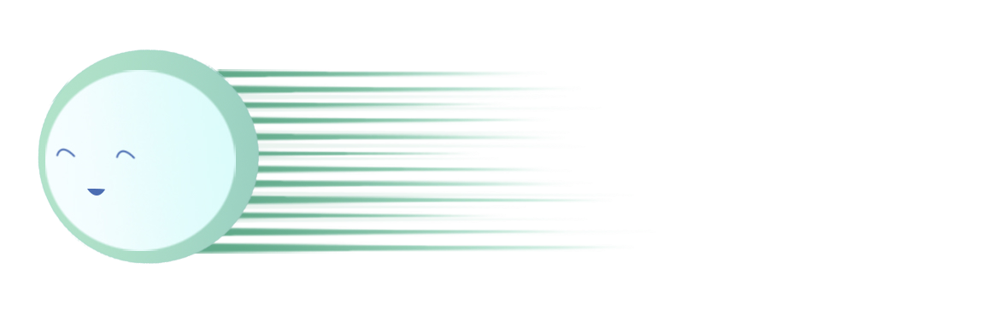
W EAKLY
I NTERACTING
χ
M ASSIVE
P ARTICLES
Consider a particle that is expected to interact with the gravitational force; it must have mass *
And allowing this particle to interact weakly with ordinary matter (Higgs Boson or new Bosons yet to be discovered ) would allow for its detection
This builds up the regime for WIMPs – Dark Matter Particle

Slide 4
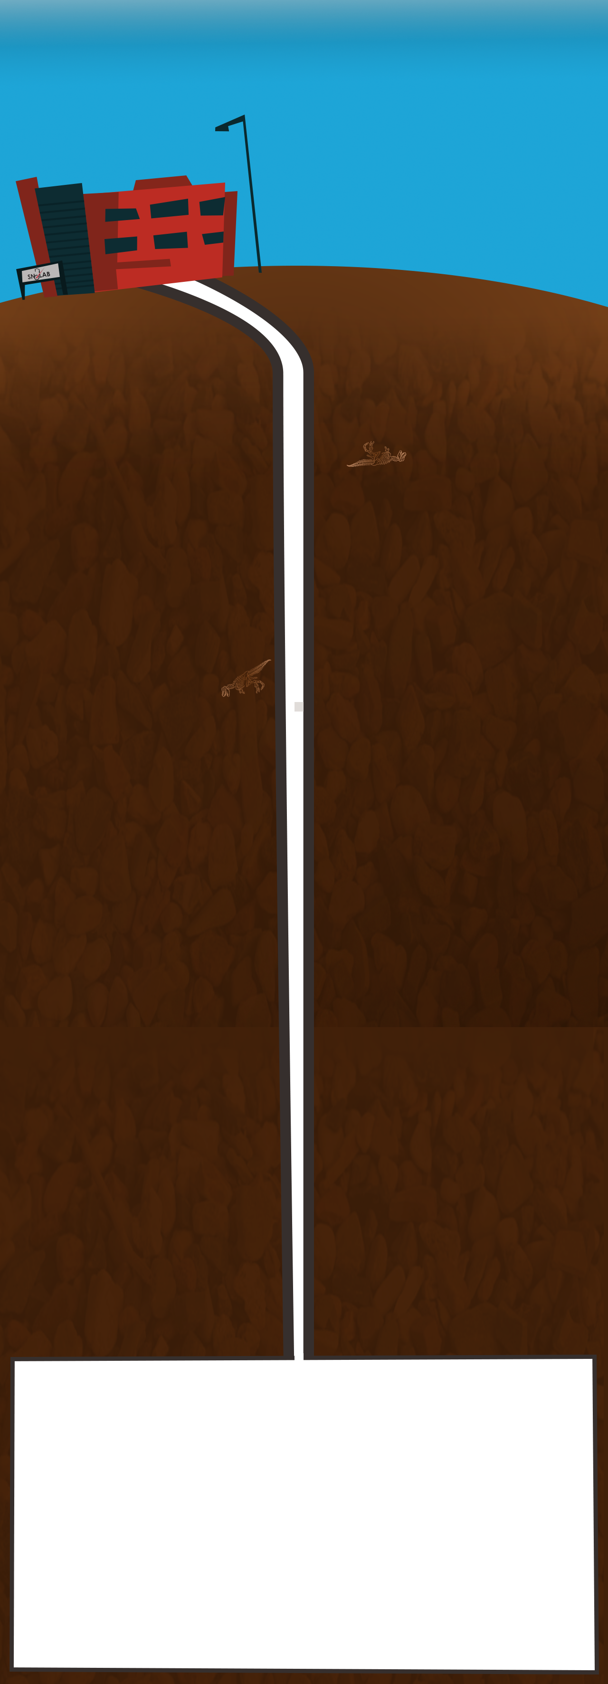
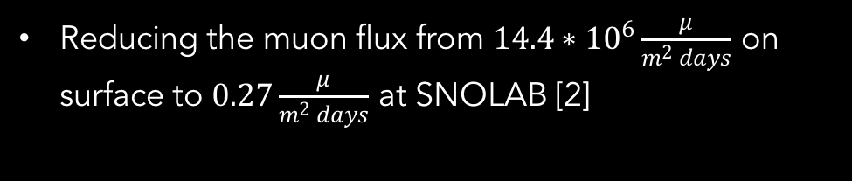
Ultra Low Background Radiation Environment
The DEAP-3600 experiment required the detector to be in a virtually background radiation free environment
Where as this is not possible the next best place was chosen, SNOLAB
Reducing the muon flux from $14.4∗{10}^{6}\frac{μ}{m^{2} days}$ on surface to $0.27\frac{μ}{m^{2} days}$ at SNOLAB [2]
[2] http://snolab2008.snolab.ca/snolab_users_handbook_rev02.pdf

Slide 5
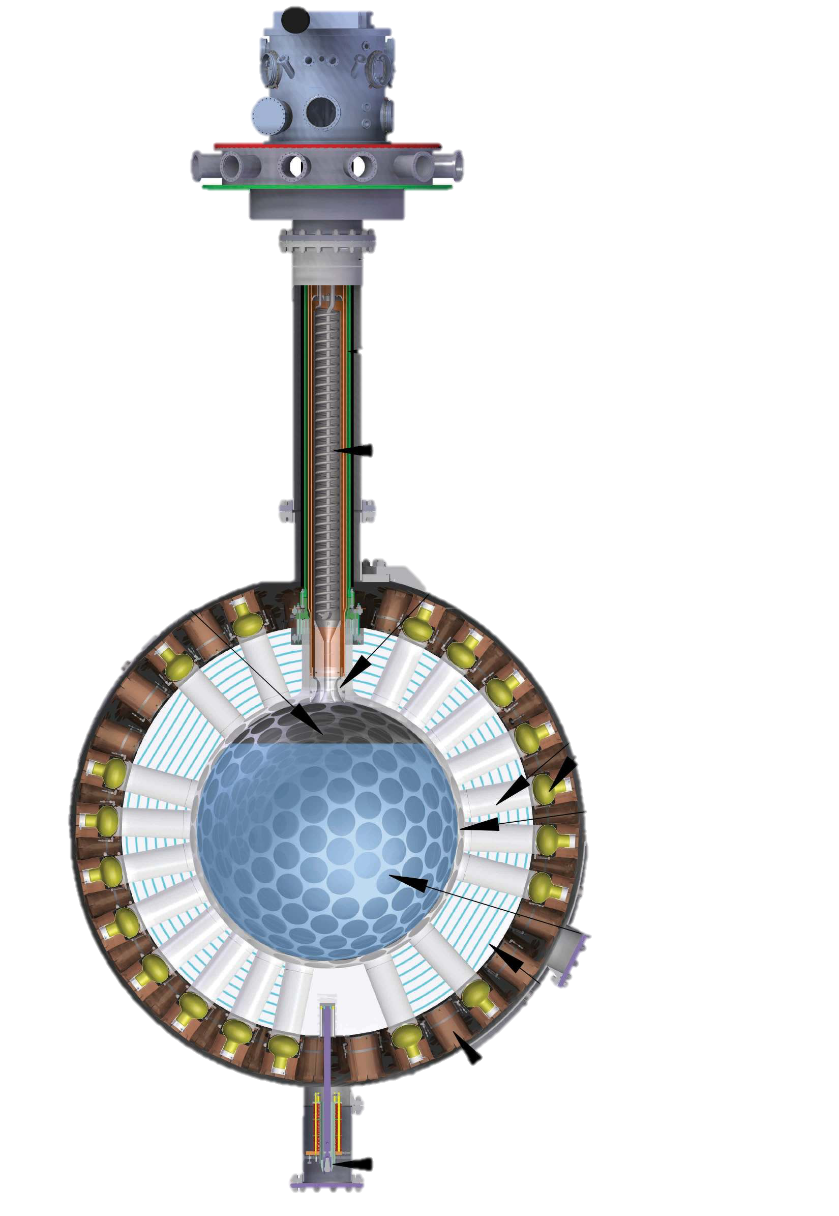
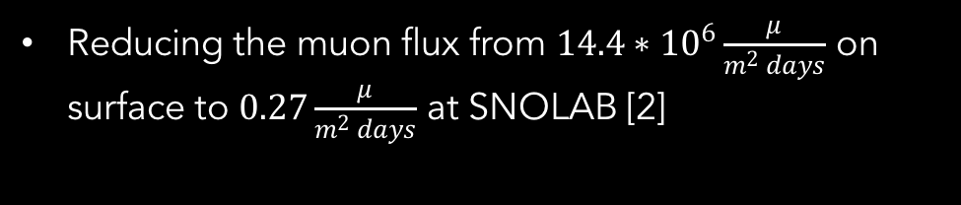
Ultra Low Background Radiation Environment
The DEAP-3600 experiment required the detector to be in a virtually background radiation free environment
Where as this is not possible the next best place was chosen, SNOLAB
Reducing the muon flux from $14.4∗{10}^{6}\frac{μ}{m^{2} days}$ on surface to $0.27\frac{μ}{m^{2} days}$ at SNOLAB [2]
Gaseous Argon
3259 kg Liquid Argon
Light-guides
Photo Multiplier Tubes
TPB Layer - Wavelength Shifter
Acrylic Vessel

Slide 6
Ultra Low Background Radiation Environment
The DEAP-3600 experiment required the detector to be in a virtually background radiation free environment
Where as this is not possible the next best place was chosen, SNOLAB
Reducing the muon flux from $14.4∗{10}^{6}\frac{μ}{m^{2} days}$ on surface to $0.27\frac{μ}{m^{2} days}$ at SNOLAB [2]
Our Detector
We are looking for WIMPs interacting with nuclei in our detector
The interacting medium is 3259kg of Liquid Argon (LAr) in an Acrylic vessel which is surrounded by 255 Photo Multiplier Tubes (PMTs)
Gaseous Argon
3259 kg Liquid Argon
Light-guides
Photo Multiplier Tubes
TPB Layer - Wavelength Shifter
Acrylic Vessel
χ

Slide 7

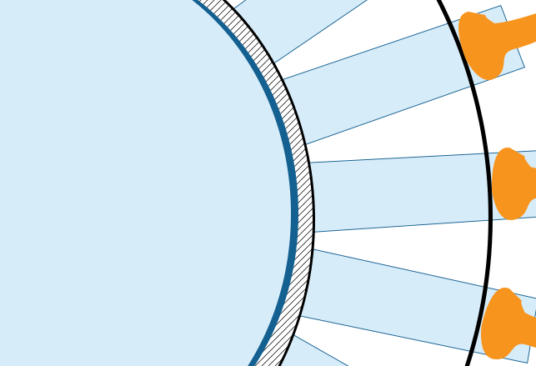
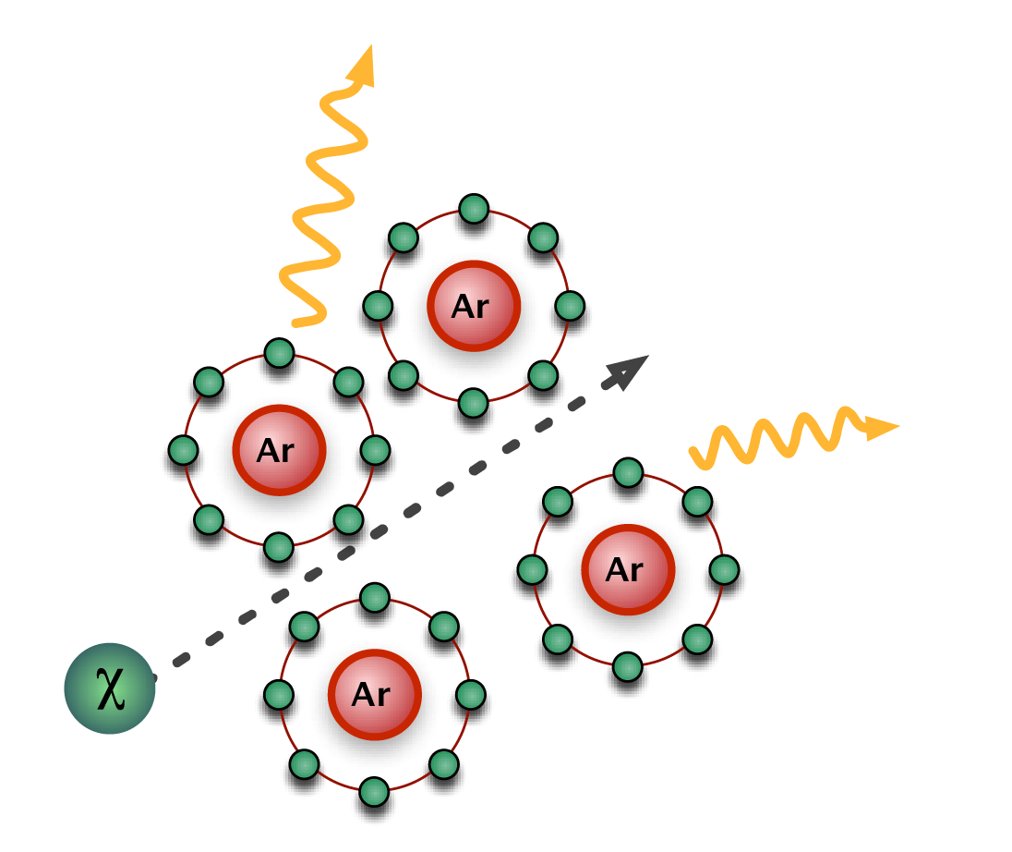

WIMP – Argon Interaction
When an event occurs in the LAr, UV photons are emitted from the location of the interaction out towards the PMTs
When it reaches the surface of the vessel its wavelength shifted to visible blue light, which the PMTs are more sensitive
It then propagates to the PMTs via light-guides where the event signal is recorded

Slide 8
Backgrounds We Expect
Argon has a natural isotope: Ar39 with a radioactivity of 1 Becquerel/kg
  This means we see ~3259 events/sec of background
  Fortunately we can reject it using Pulse Shape Discrimination
There are also trace amounts of uranium and thorium in the detector whose decay products present notable alpha backgrounds
  The alpha decays we are concerned about are from the surface of the detector

Slide 9
The P in DEAP
Pulse Shape Discrimination
Ar39 produces delayed light, with a life-time of ~1300ns
This allows for rejecting the Ar39 background using the shape of the pulse

Slide 10
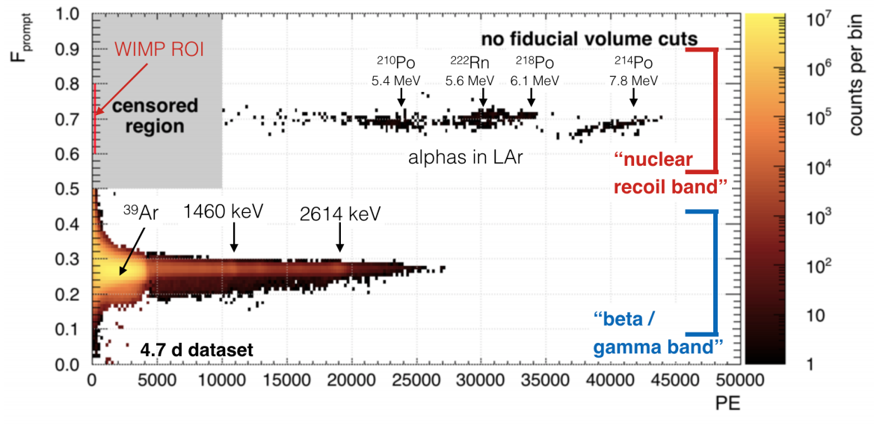
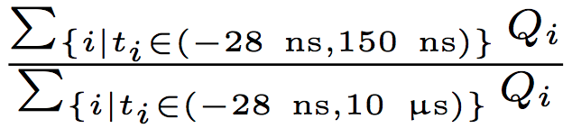
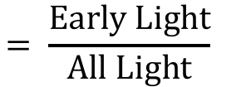
F _{prompt} ≡
$$= \frac{\text{Early} \text{Light}}{All Light}$$

Slide 11
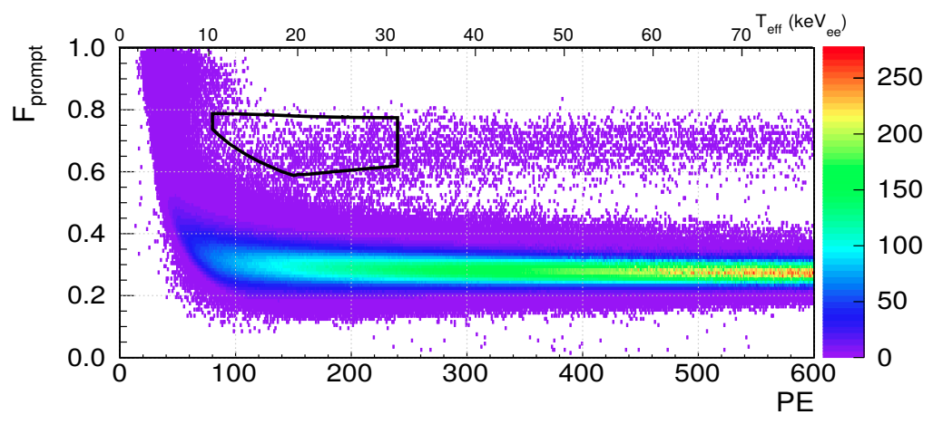
Our Region of Interest (ROI)
Neutron source calibration - After event selection

Slide 12
Our Region of Interest (ROI)
This exclusionary region is where we expect to see WIMP candidate events in physics data without neutron source

Slide 13
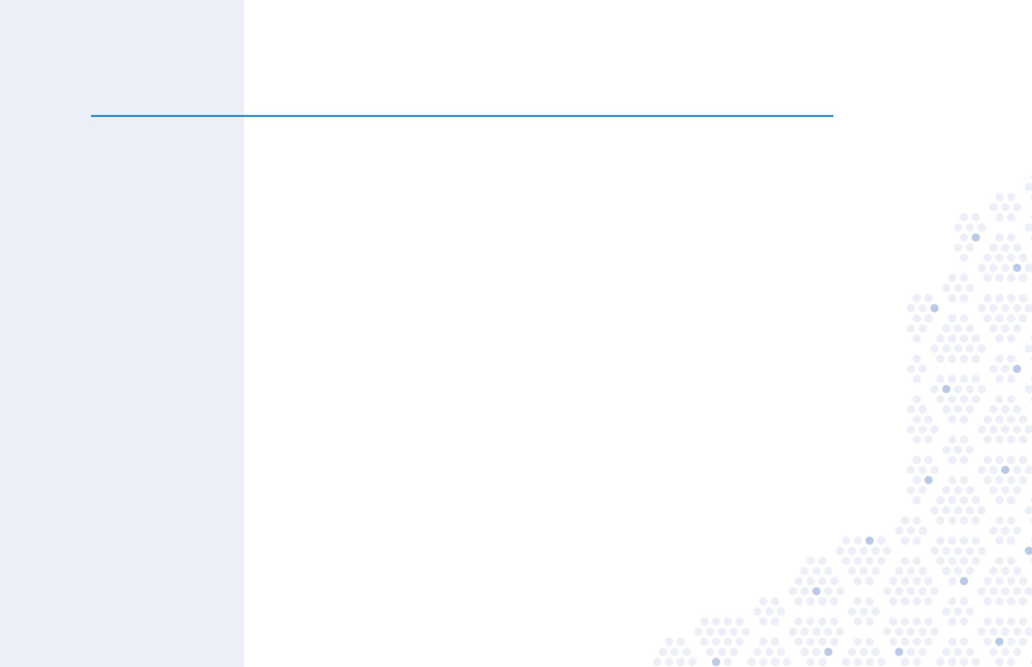
Waveform of Signal and Fits
The black line is the waveform form a PMT
The green Line is the exponential lifetime of Triplet light
The yellow line is an after pulse which results in the feature at ~7000ns

Slide 14

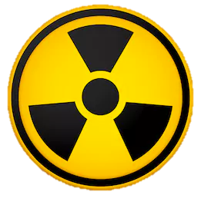
Position Reconstruction
When an events occurs in the detector, its position is not a given and has to be determined using position reconstruction algorithms
  Critical for cutting out surface background event using fiducialization
DEAP-3600 position reconstruction algorithms:
  Charge Based
    Considers the amount of light seen by all the PMTs and PMT positions to determine the position of the event
Fiducial
Radii

Slide 15
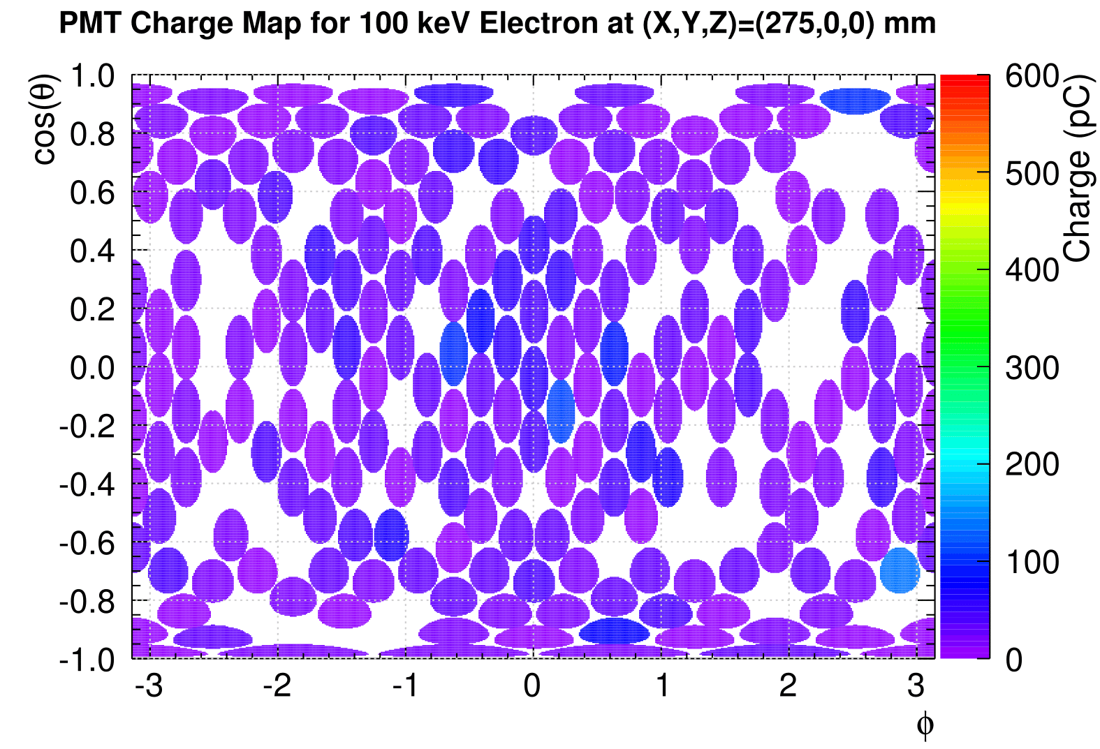
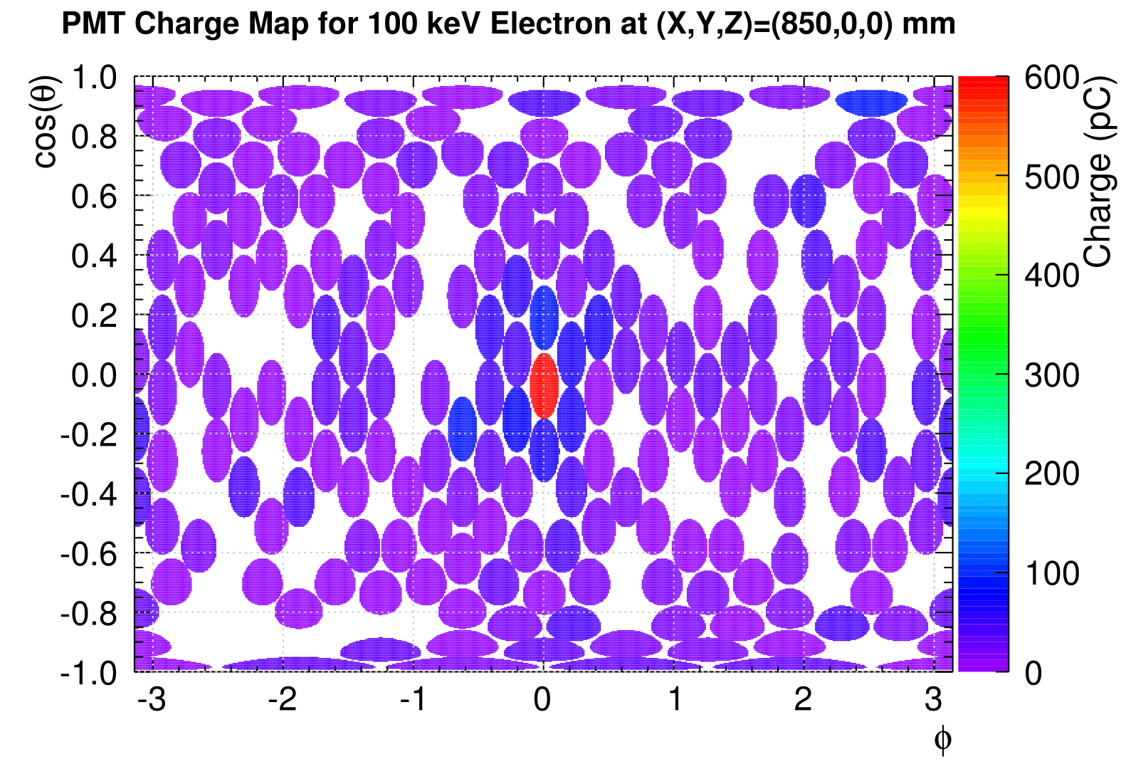
Charge based Fitters
If all PMTs detect about the same amount of light, then it can be said that the event occurred in the center of the detector
If one PMT detects a great amount of light, then the event must have occurred closer to that PMT.
However this type of fitter is sensitive to some instrumental effects
  After-pulsing can cause a PMT to detect more light then what was just produced from the event and thus force the fitter to reconstruct the event closer to the surface

Slide 16
Unadjusted vs Adjusted
Waveform
Unadjusted waveform is a measurement of all the light detected by all of the PMTs
  However this light measure also includes after-pulsing artefacts
Adjusted waveform uses Bayesian statistics to assign all PMT pulses a probability of being from scintillation.
  Position reconstruction based on adjusted waveform does not include after pulsing

Slide 17
Monte Carlo Simulation (MC)
We can use MC software simulated events to study the fidelity of our reconstruction algorithm
MC events have information about the true position of the event and the reconstruction position
This allows us to study reconstruction algorithms against each other and compare reconstructed and true positions

Slide 18

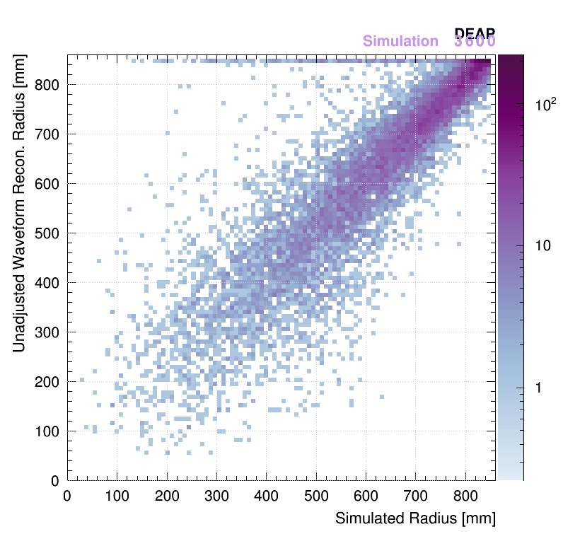
Event Radius
True vs charge fitter position of event
using unadjusted waveform

Slide 19
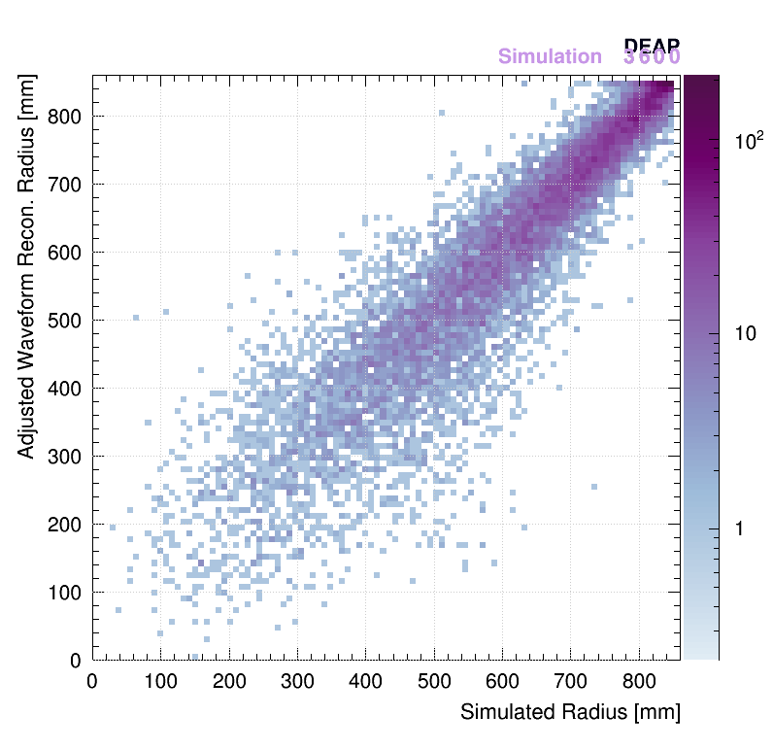
Event Radius
True vs charge fitter position of event
using adjusted waveform

Slide 20
True position of event vs charge fitter position using unadjusted waveform
True position of event vs charge fitter position using adjusted waveform

Slide 21
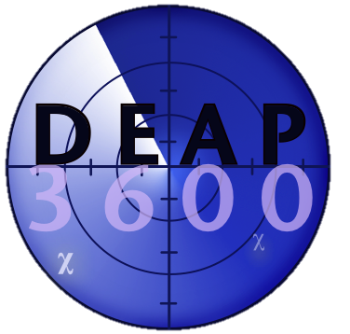



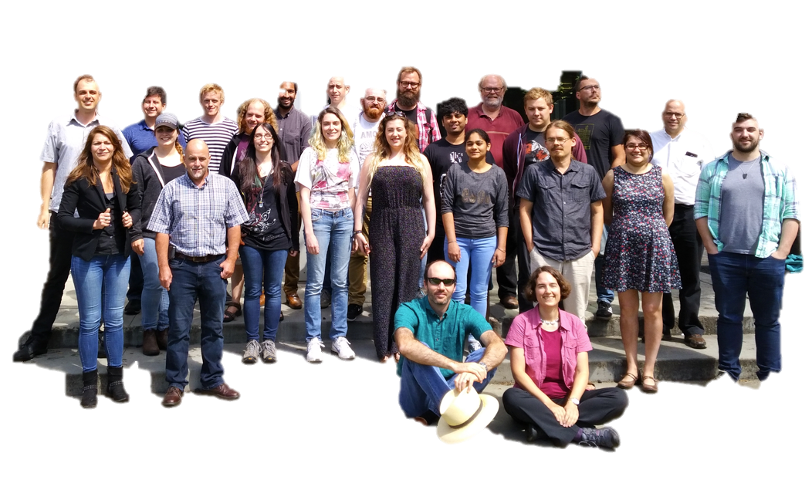
Acknowledgement
I’d like to thank my supervisor Dr. Simon Viel and everyone in the DEAP-3600 collaboration.
Conclusion
DEAP-3600 is a incredibly sensitive detector
Position Reconstitution of events is a critical part of DEAP-3600’s mission to find Dark Matter
Showing that the Adjusted Waveform energy estimator results in a better reconstruction allows a larger fiducial radius
Next step
Benchmark the performance of position reconstruction algorithms against surface alpha background events
Better understand systematic uncertainties on position reconstruction

Slide 22
Acknowledgement
I’d like to thank my supervisor Dr. Simon Viel and everyone in the DEAP-3600 collaboration.
Learning Through Experience
Having the opportunity to get hands on experience is undoubtedly one of the rewarding part of my experience working with the DEAP-3600 collaboration
Sharped skills such as
  Working in a large team and still contributing is a significant way
  Solving physics problems outside the “sphere in a vacuum” model
  Meditation
    For when ROOT just isn’t working the way it should
  Programming for high performance computing clusters

Slide 23

Acknowledgements
I’d like to thank my supervisor Dr. Simon Viel and everyone in the DEAP-3600 collaboration.
Learning Through Experience
Having the opportunity to get hands on experience is undoubtedly one of the rewarding part of my experience working with the DEAP-3600 collaboration
Sharped skills such as
  Working in a large team and still contributing is a significant way
  Solving physics problems outside the “sphere in a vacuum” model
  Meditation
    For when ROOT just isn’t working the way it should
  Programming for high performance computing clusters

Slide 24

Thank You!
References
[1] P. A. R. Ade et al. (Planck), Astron. Astrophys. 594, A13 (2016)
[2] http://snolab2008.snolab.ca/snolab_users_handbook_rev02.pdf
[3] First Rasuls from The DEAP-3600 Dark Matter search with argon at SNOLAB, DEAP Collaboration arXiv:1707.08042
[4] Backgrounds in the DEAP-3600 Dark Matter Experiment, B. Lehnert (arXiv:1805.06073)
[5] Simulation Study of the use of Internal Ar-39 Beta Decays for Energy Calibration of the DEAP-3600 Dark Matter Detector
Connor Stone, Chris Jillings, and Tina Pollmann for the DEAP Collaboration

Slide 25
Extra Slides

Slide 26

Other Systematics Uncertainties
TPB Scattering
  The wavelength shifter scatters the light from an event and it’s not precisely known how much of the light is lost to this scatter
Refractive index
  The refractive index of Liquid Argon is not very well known for UV light
PMT Efficiency
  Our PMTs are calibrated in two ways, day zero calibration (laser ball) or daily testing. A miss-calibration in the PMT’s efficiency can make it seem as thought it sees more or less light then it does/ relative to others
After Pulsing
And others

Slide 27
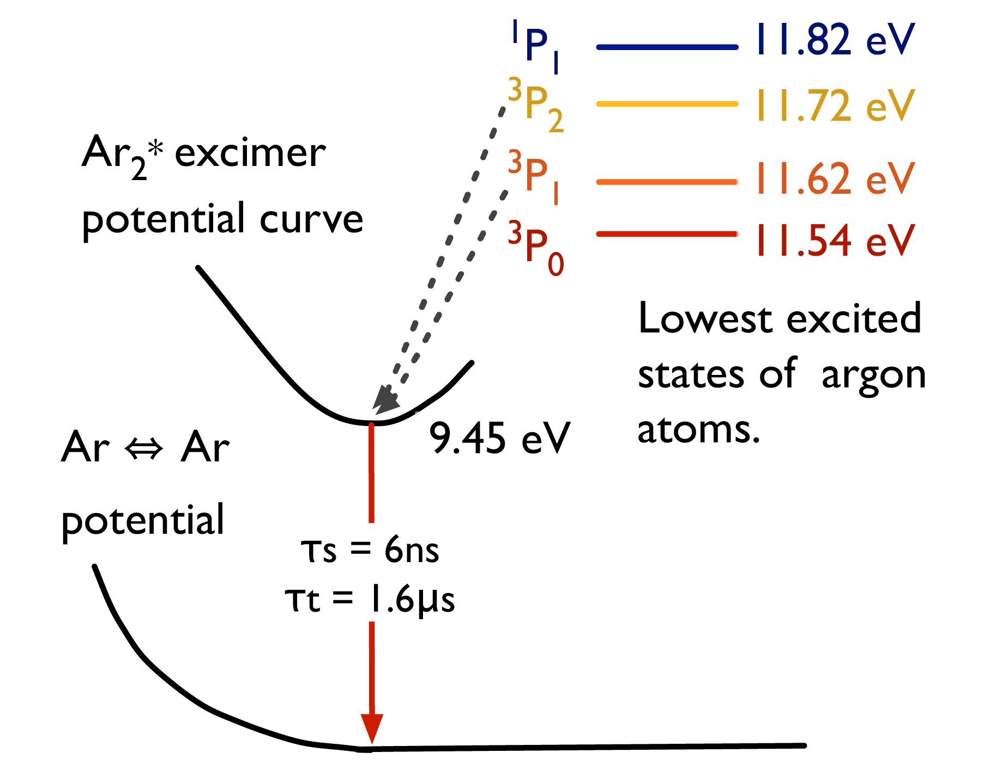

⁴⁰Ar → ³⁹Ar Energy Exchange
The singlet state decay is an allowed
transition with a lifetime
of 6.7 ns.
While the triplet state
decay is “forbidden” and thus has
a much longer lifetime of about
1600 ns[5].
This is the basis for
electron and photon background suppression used in DEAP.
128 nm Photon
[5] Simulation Study of the use of Internal Ar-39 Beta Decays for Energy Calibration of the DEAP-3600 Dark Matter Detector, Connor Stone, Chris Jillings, and Tina Pollmann for the DEAP Collaboration

Slide 29
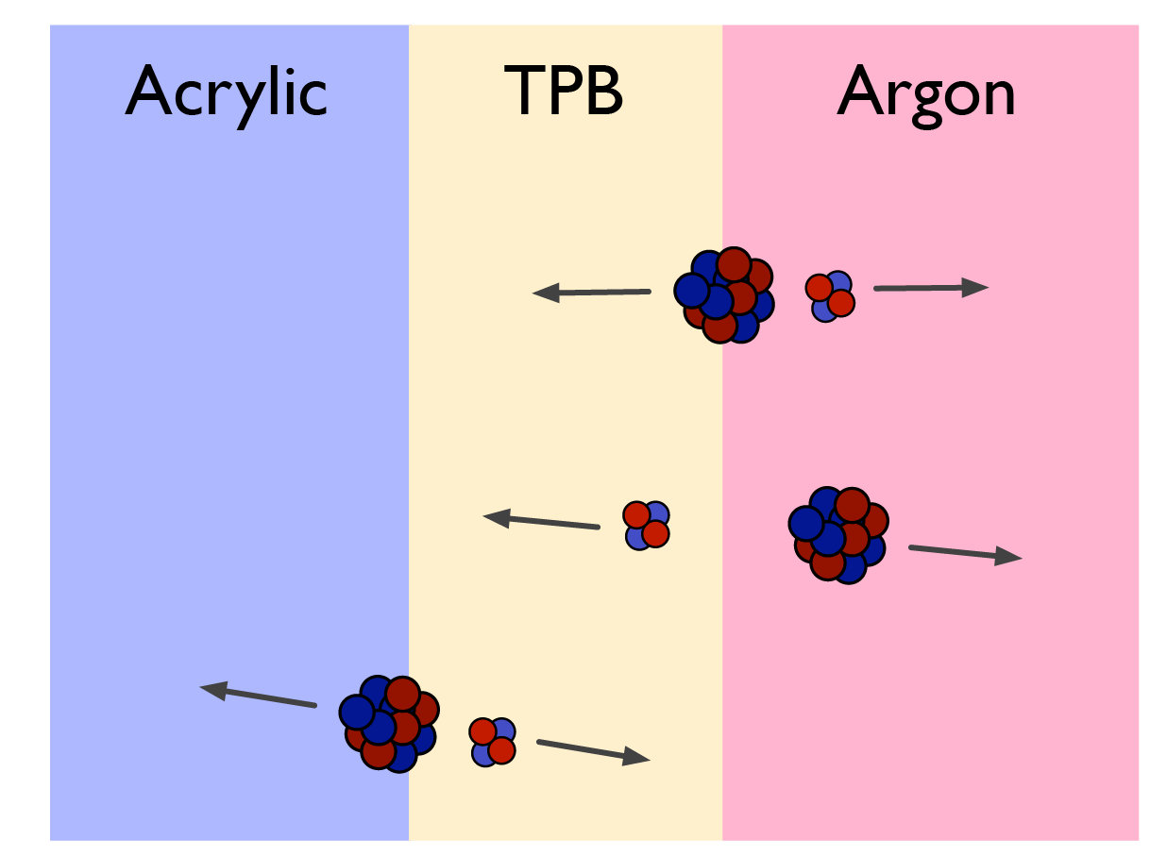
Alpha emitter on surface
1)
2)
3)

Slide 30
Uranium and Thorium Decay Chain
1)
2)
3)

Slide 31

Our Region of Interest
99% nuclear recoil region of acceptance
Notes:
Checkton light

Slide 32
Our Region of Interest
95% nuclear recoil region of acceptance

Slide 33
Our Region of Interest
Electron Recoil region

Slide 34
Our Region of Interest
End point for alpha events leaking

Slide 35
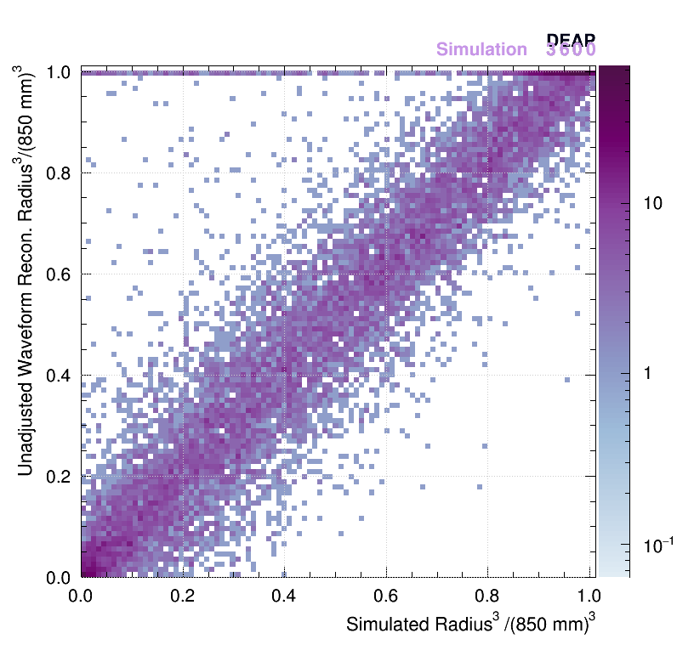
R³
Unadjusted waveform

Slide 36
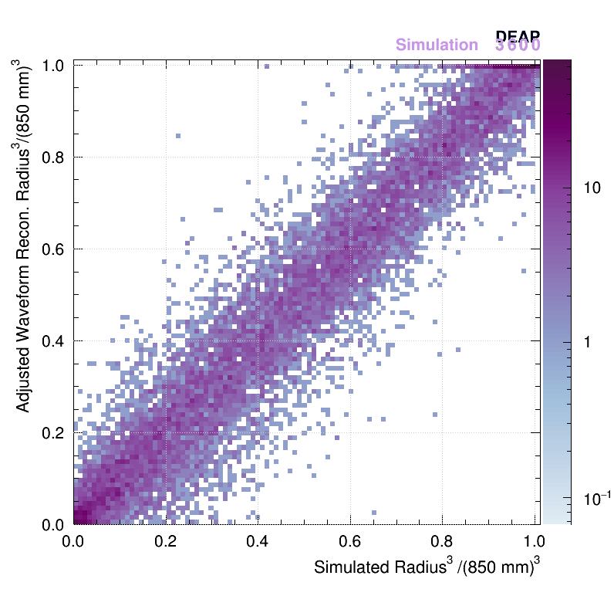
R³
Adjusted waveform

Slide 41
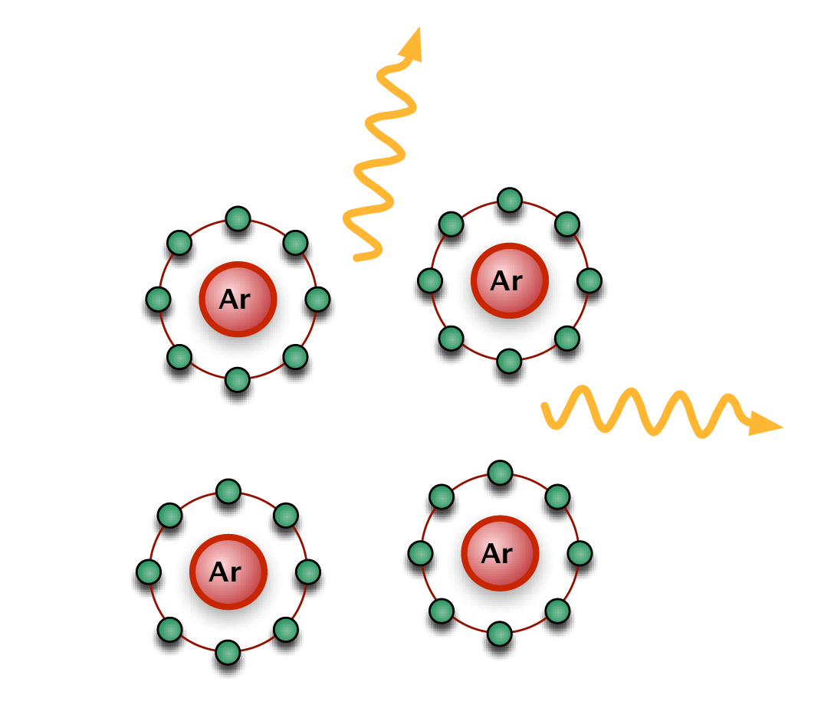
WIMP – Argon Interaction
When an event occurs in the LAr, UV photons are emitted from the location of the interaction out towards the PMTs
When it reaches the surface of the vessel its wavelength shifted to visible blue light, which the PMTs are more sensitive
It then propagates to the PMTs via light-guides where the event signal is recorded

