Slide 1
LEERO
Low Energy Electron Range Observation

Slide 2
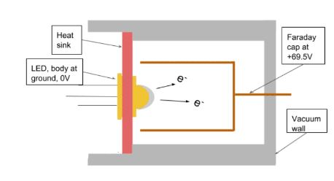
Initial Interest: Electron Cannon Construction
Two Interests:
Yield versus thickness.
Range of a low energy electron
Low temperature electron cannon

Slide 3
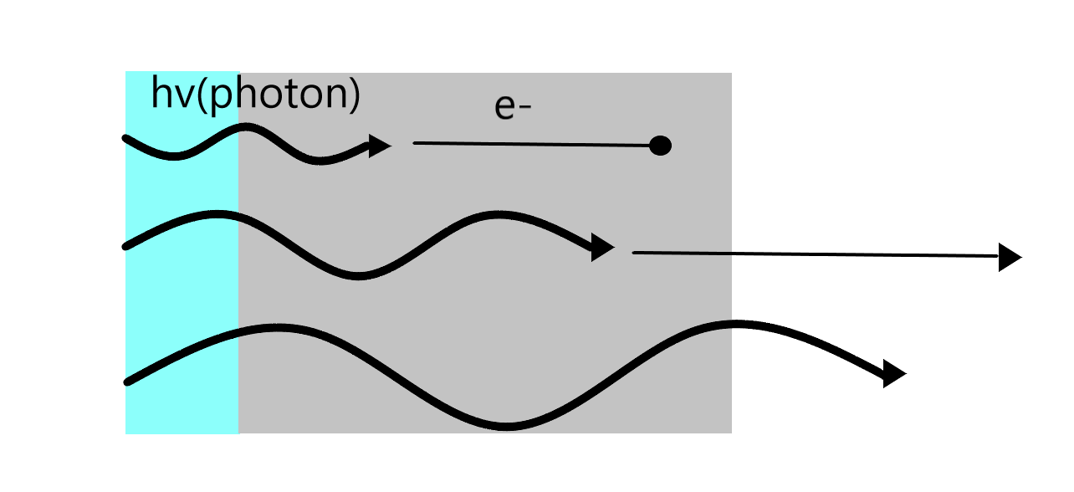
Drawing
LED Lens
Silver Deposit

Slide 4
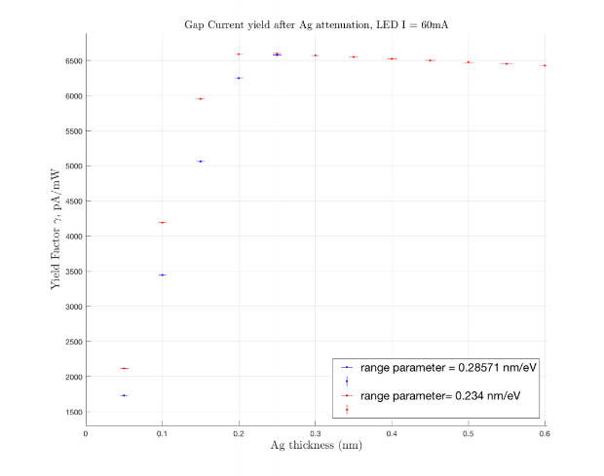
Predictions
Gap current yield versus thickness, LED I = 60 ma
As thickness approaches range from 0, yield increases because more events between the film and photons happen.
As thickness increase past the range, more of ejected electrons are unable to make it out of the solid.

Slide 5
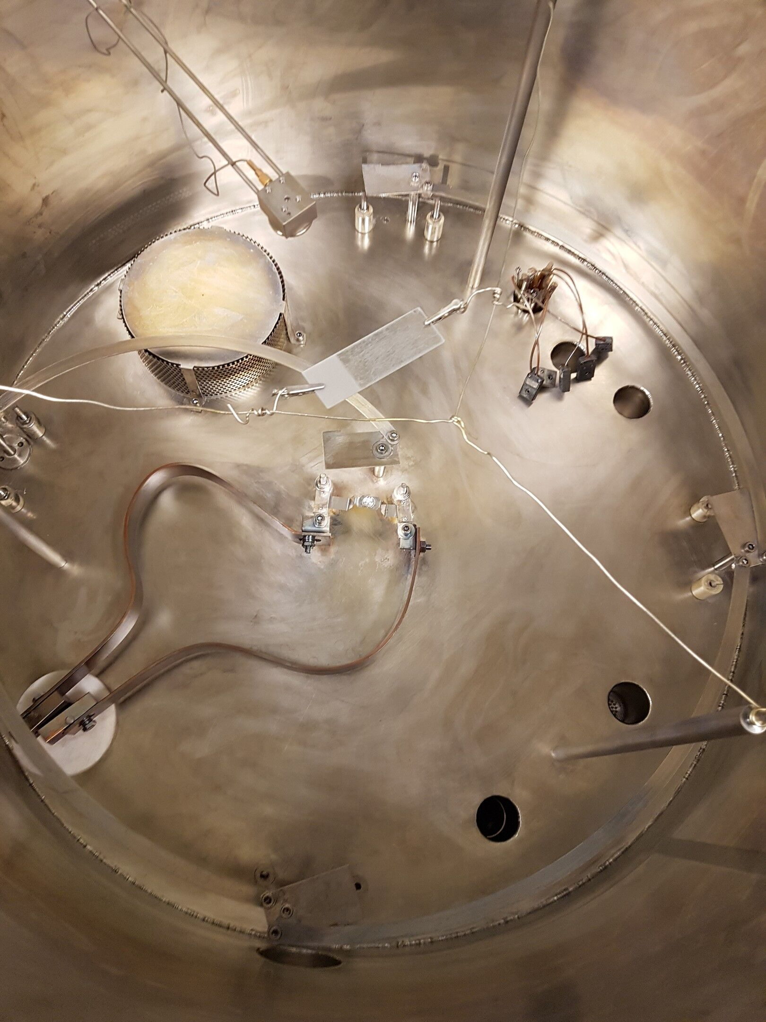
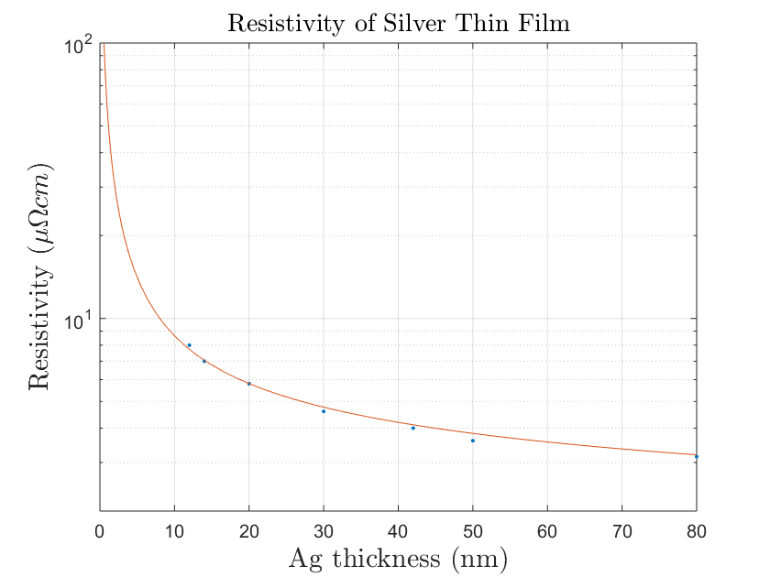
Investigations: Deposited Thickness
Compared thickness observed by the crystal quartz monitor to the difference in mass of the target.
50%-10% discrepancy using indium
Indium was re-evaporating
3% discrepancy using silver
Inside the range of our errors
Resistivity is not constant for very thin films.
High resistance would cause capacitance.
Worst case: 0.1 µV produced. Assumed to be negligible.

Slide 6
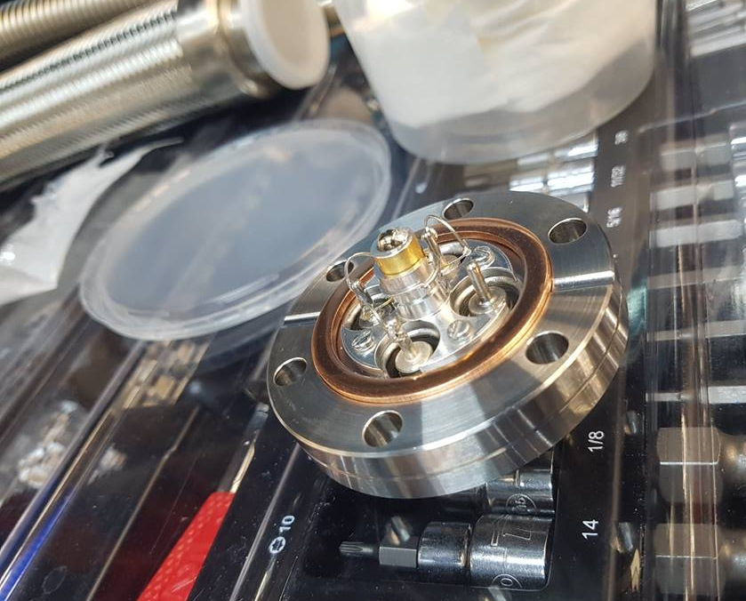
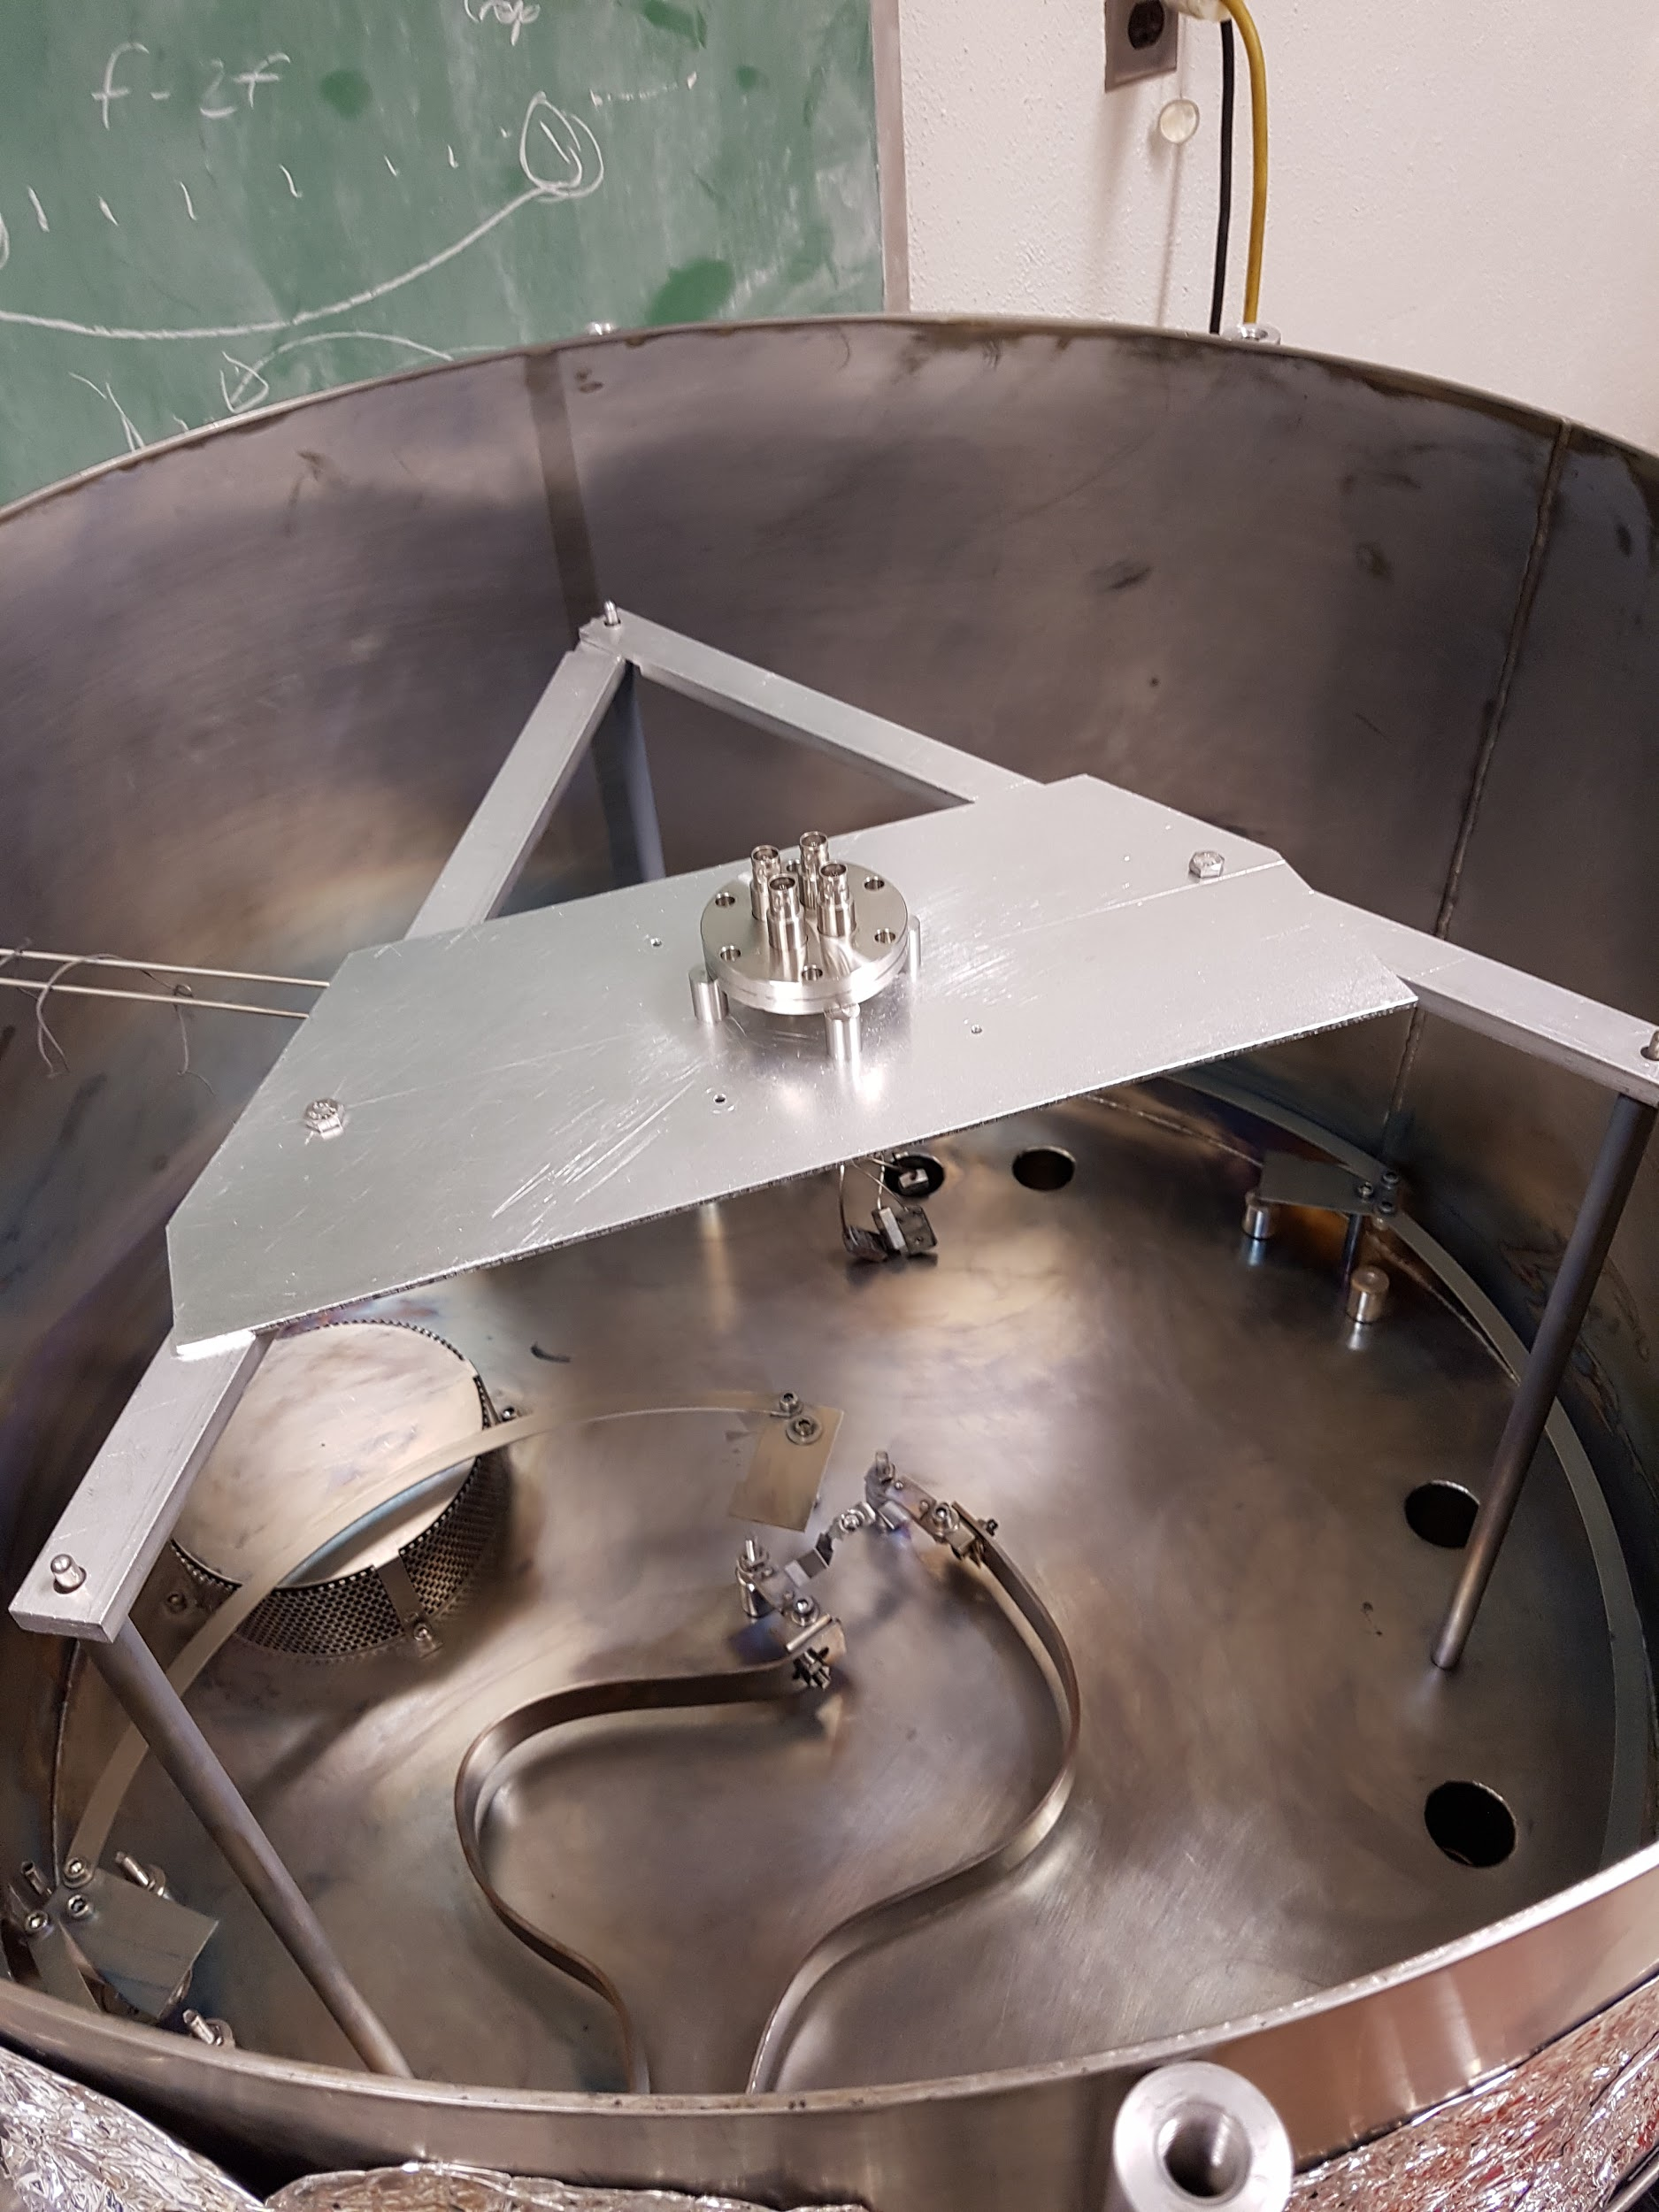
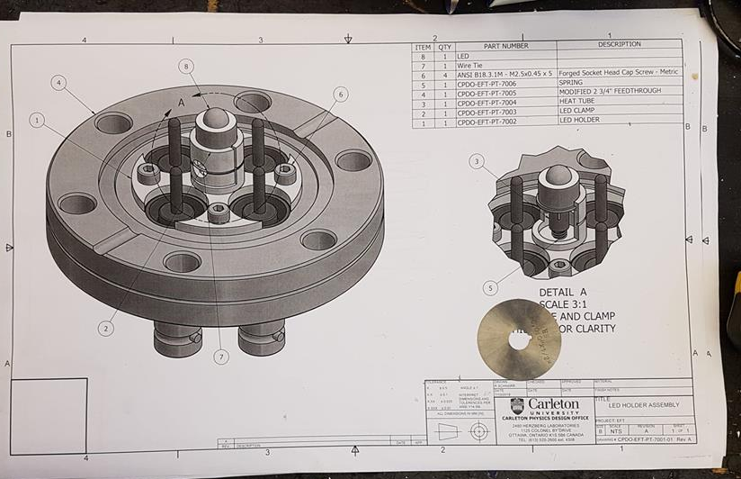
Modifications

Slide 7
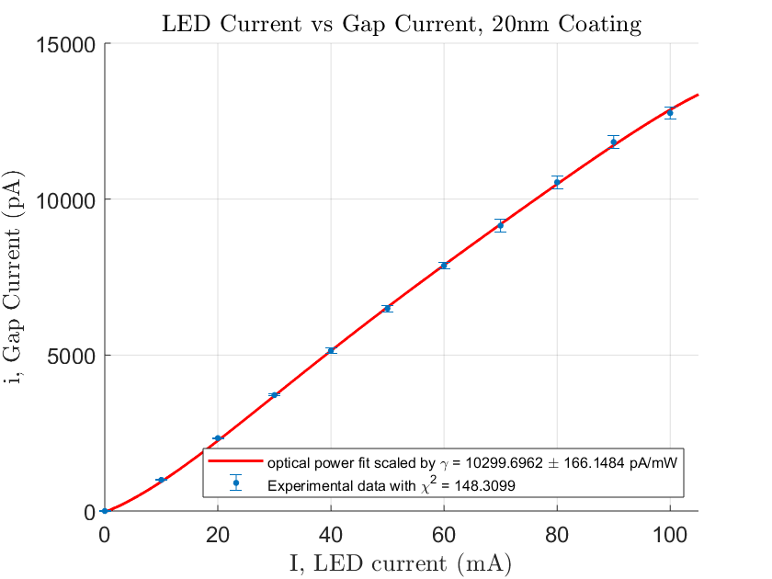
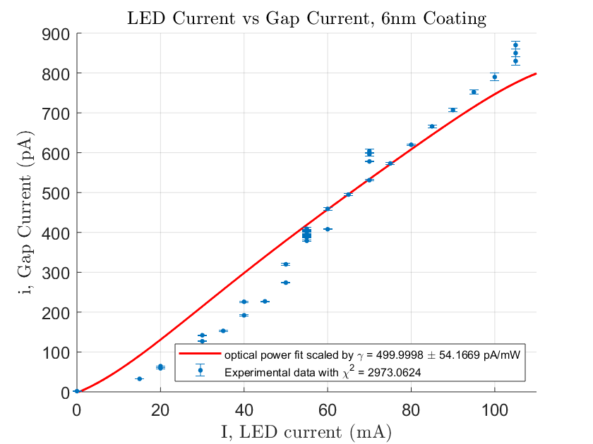
Photoelectric Efficiency Data per Thickness

Slide 8
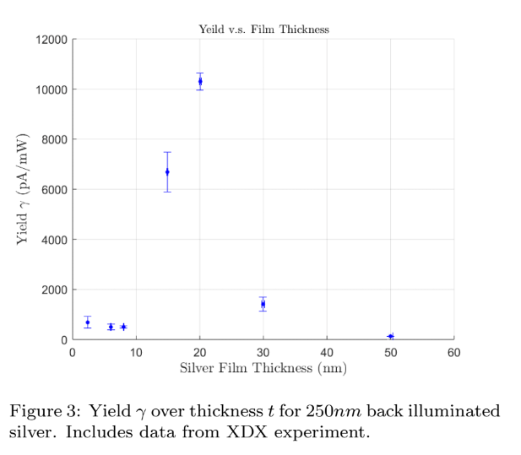
Yield as Function of Thickness

Slide 9
What I have Learnt this Summer
Matlab
Latex
Excel
Vacuum systems
Circuits
Basic manufacturing
Clean room procedures
Compressed Gasses
Deriving toy models and equations
Finding and Scanning research paper’s
Professional Formatting of Paper’s
Teamwork and communication skills

Slide 10
Most important thing I Learned this Summer
How to deal with the ups and downs of a real project.
How to think critically to solve physics problems.

Slide 11
Conclusion
Most probable issues:
Internal issue of LED. Heating in vacuum breaks the LED.
Life of LED in these condition is too small.
Sucess’s:
Yield over thickness was successfully measured.
Accuracy can be drastically improved
Deposition thickness accuracy was confirmed.
Had an extremely valuable summer.

Slide 12
Lastly, Thank you to the Dean Summer Reasearch Internship and to Dr. Razvan Gornea and Mr. Austin de St. Croix for this opportunity and help along the way.

