Slide 1
An analysis of X-ray scatter images using convolution and Fourier transform techniques
by Cristian Ciobanu
supervised by Dr. Paul Johns
September 17, 2018

Slide 2


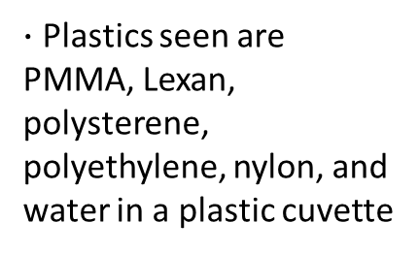
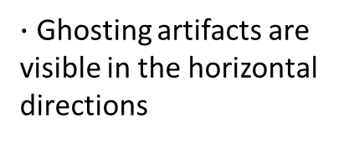
The scatter image
$∙$ 5-beam scatter x-ray image
$∙$ Plastics seen are PMMA, Lexan, polysterene, polyethylene, nylon, and water in a plastic cuvette
$∙$ Better soft tissue contrast
$∙$ Ghosting artifacts are visible in the horizontal directions

Slide 3
Presentation roadmap
x ray foundation
Fourier transform
convolution
conclusions
scatter image
construction
Fourier transform
application
convolution
application

Slide 4
How are these images made?
TYPES OF RADIATION
The Electromagnetic Spectrum
low frequency
high frequency
microwaves
infrared
visible light
ultraviolet
x rays
gamma rays
X rays – have many applications in the real world
    Medical diagnosis
    Airport security

Slide 5
How are these images made?
TYPES OF X-RAY PHOTON INTERACTIONS
Photoelectric interaction
Compton interaction
Coherent interaction
Ejected electron
Ejected electron
Scattered photon
Nucleus
Nucleus
Scattered photon
Nucleus
Incident photon
Incident photon
Incident photon
Both are examples of scattered
x rays, but we are only concerned with
coherent scatter

Slide 6
How are these images made?
CONSTRUCTING THE IMAGE
Scatter Pattern
Radial Profile
Scatter Image

Slide 7
How are these images made?
MULTI-BEAM SCATTER IMAGES
1
single-beam image
1
2
3
4
5
five-beam image

Slide 8


Possible solutions
High end:
Post-processing of the image
Is there a consistent pattern?
The focus of this research!
Low end:
Fixing the root of the problem
Disentanglement algorithm
$∗$ images courtesy of Negative Space and Pixabay (free for commercial use under the CC0 license)

Slide 9
The Fourier transform
spatial domain
frequency domain
strength of function
strength of sinusoid
space
frequency
The Fourier transform breaks a function down
into its sinusoidal components

Slide 10
The Fourier transform
Original image (five-beam)
Fourier transform
Vertical streaks are present
Are they a result of…
  Ghosting?
  Rectangular structures?
  Hexagonal pixels?

Slide 11
Analyzing the Fourier transform
Original image (single-beam)
Fourier transform
No ghosting (don’t have to disentangle multiple radial profiles)
Similarities to five-beam image include rectangular structures and hexagonal pixels
Looks similar to Fourier transform of five-beam image
Vertical streaks still present
  Probably don’t contribute to ghosting!

Slide 12
Analyzing the Fourier transform
Synthetic image (ideal)
Fourier transform
Similarity to five-beam image is the rectangular structures
Looks like the Fourier transform of the scatter images but without the vertical streaks
  Not due to rectangular structures!

Slide 13




Analyzing the Fourier transform
11x11 square ($rect$ function)
Fourier transform ($sinc$ function)
(11 vertical streaks
in Fourier transform)
51x51 square ($rect$ function)
Fourier transform ($sinc$ function)
(51 vertical streaks
in Fourier transform)

Slide 14

Analyzing the Fourier transform
Original image (five-beam)
Fourier transform
The vertical streaks are a result of the hexagonal pixels!
$\sim$ 15 square pixels

Slide 15
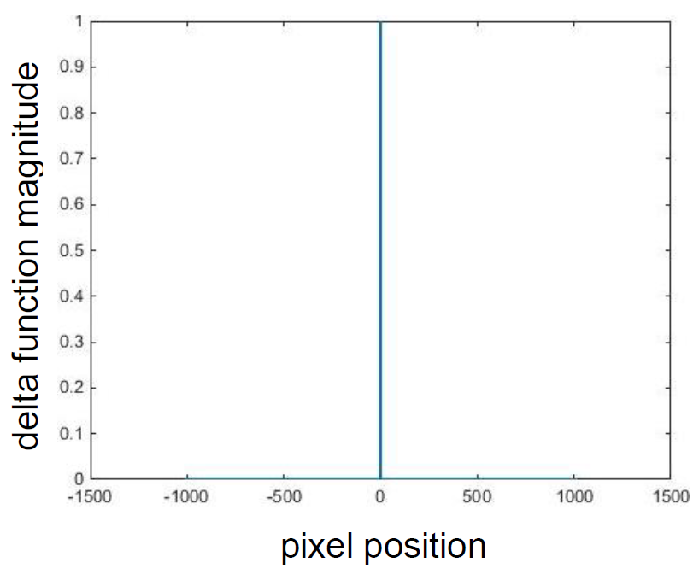
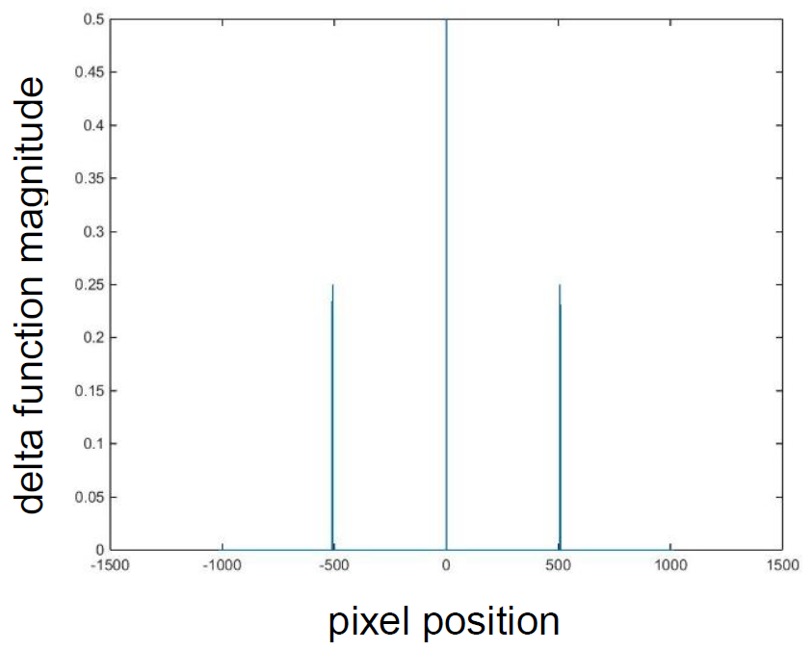
Convolution
kernel

Slide 16
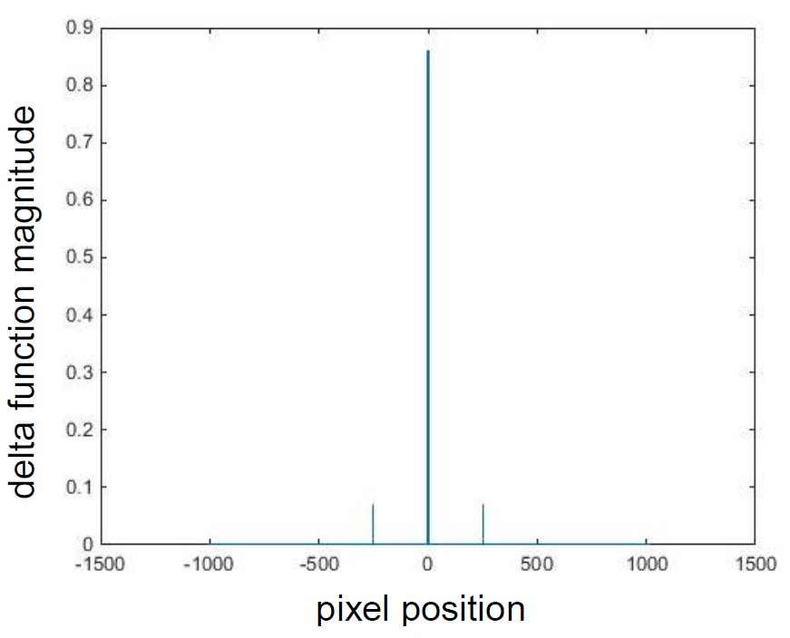


Convolution
?
$$\text{∗}$$
$$=$$

Slide 17
Convolution
beam spacing

Slide 18
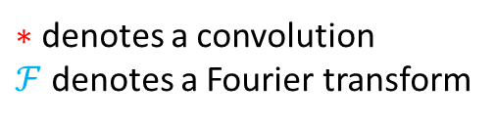

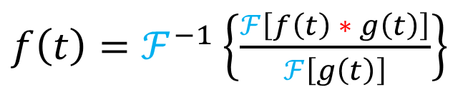
Convolution Theorem and Deconvolution
$$\text{ℱ}\text{[}\text{f}\text{(}\text{t}\text{)}∗\text{g}\text{(}\text{t}\text{)] = }\text{ℱ}\text{[}\text{f}\text{(}\text{t}\text{)] }\text{ℱ}\text{[}\text{g}\text{(}\text{t}\text{)]}$$
$\text{∗}$ denotes a convolution
$\text{ℱ}$ denotes a Fourier transform
$f\left(t\right)=ℱ^{−1}\left\{\frac{ℱ\left[f\left(t\right) ∗ g\left(t\right)\right]}{ℱ\left[g\left(t\right)\right]}\right\}$

Slide 19
Deconvolving the image
(original)

Slide 20
Deconvolving the image
Improved but not perfect
Add more delta functions
Low-end approach
(deconvolved)

Slide 21
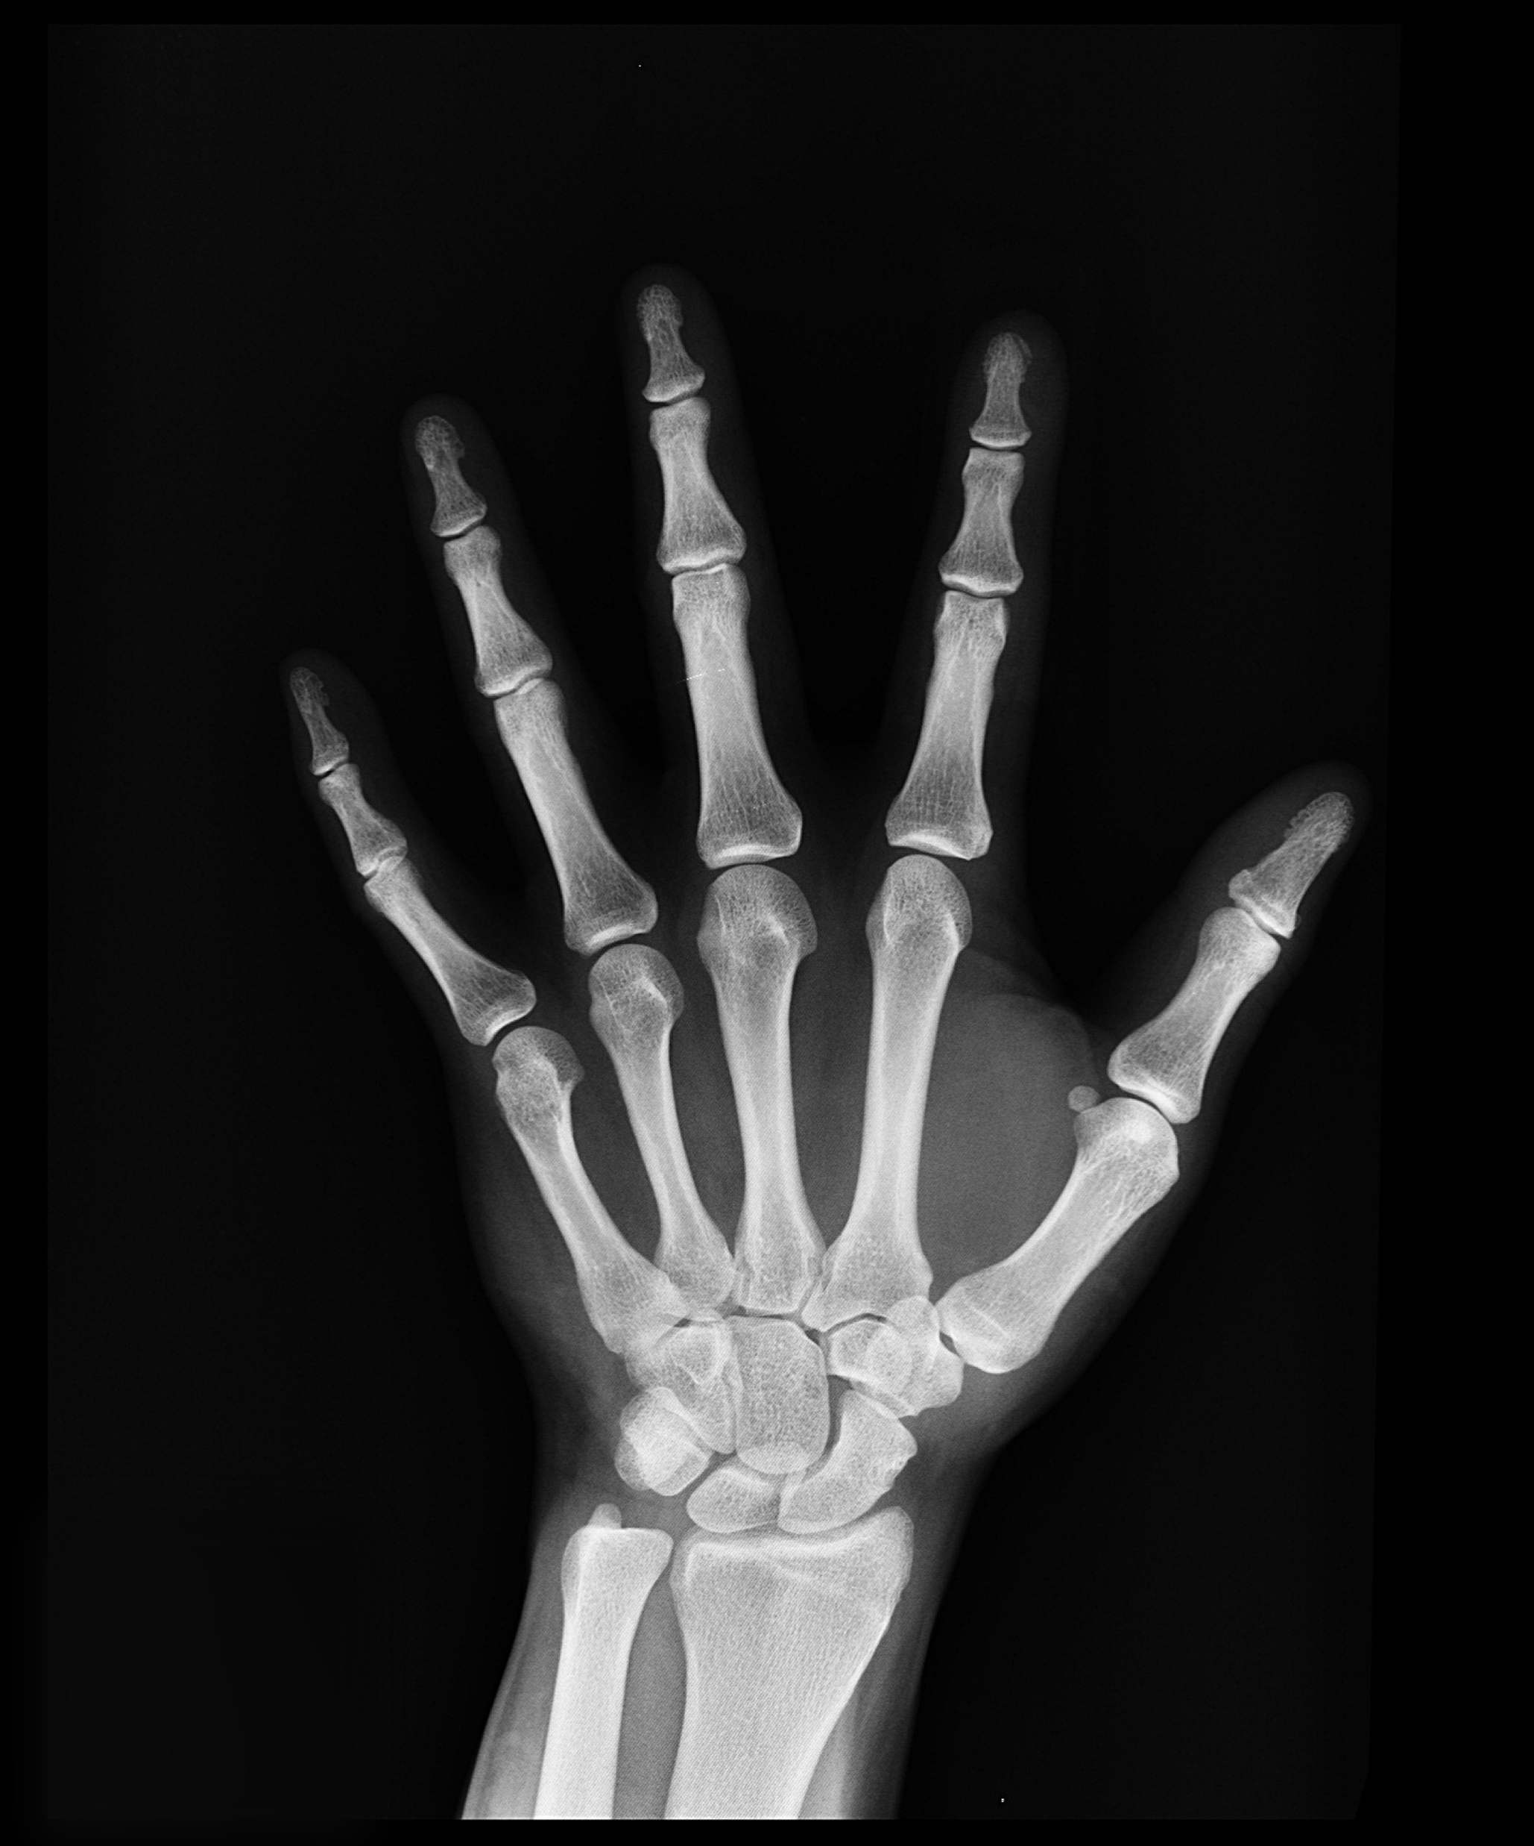



Working as a summer student
Got to work in a field of interest!
Medical physics
Got to apply math to the real world!
Gained experience writing lab reports!
Learned a new computer language!
MATLAB
$∗$ images courtesy of Skitterphoto, Pixabay, picjumbo, and Pexels (free for commercial use under the CC0 and Pexels license)

Slide 22
Thank you!

