Slide 1
Development of a Guided User Interface; egs_bachy GUI
Shannon Jarvis
Supervisor: Rowan Thomson
August 27, 2019
Summer Student Presentations

Slide 2
Outline
Background information on brachytherapy
Description of egs_brachy code
Purpose and process of egs_brachy GUI (Guided User Interface)

Slide 3
Brachytherapy
A type of radiation therapy where radioactive sources are placed near or within a tumor
Used to treat cancer
A treatment plan is created by assessing the dose
Dose: energy deposited per unit mass in tissue
due to radiation
Patient CT Image of chest with location of brachytherapy sources circled

Slide 4
Clinical Brachytherapy
Approximations are used to calculate the dose;
Patient is an infinite volume of water
Effect of each brachytherapy source considered individually
Doesn’t accurately represent the patient

Slide 5
egs_brachy
Developed by the Carleton Laboratory for Radiotherapy Physics
Model-Based Dose Calculation Algorithm
Uses a patient specific model to calculate dose
Patient is represented by a voxelized virtual model
3-D grid of voxels
Requires a specific format of input files

Slide 6
Purpose of egs_brachy GUI
Guided User Interface (GUI) to integrate egs_brachy with clinical data
Clinical CT Data
Series of cross-sectional images (slices)
Organ contours
Brachytherapy source
CT Image of a Test Case

Slide 7
Process of egs_brachy GUI
1) Read in clinical data
2) Create a patient model
4) Launch egs_brachy
5) Convert egs_brachy output to clinical format
3) Generate egs_brachy input files

Slide 8
1) Read in Clinical Data
Standard format
DICOM = Digital Imaging and Communications in Medicine
Hexadecimal file
An 8 character sequence, called a tag, is used to identify all data in the file
Information is extracted from all relevant tags

Slide 9
CT Image Data
Each CT image consists of a matrix of pixels that represents each volume element (voxel)
Pixels are measured in Hounsfield Units (HU)
Units of radiodensity
Related to the attenuation coefficient
Each CT machine has a calibration to convert HU to density

Slide 10
2) Create a patient model
Process begins with an empty patient model
Number of voxels is based on the number and size of CT images

Slide 11
2) Create a patient model
Process begins with an empty patient model
Each voxel has a corresponding pixel value
Number of voxels is based on the number and size of CT images

Slide 12
2) Create a patient model
Process begins with an empty patient model
Each voxel has a corresponding pixel value
Pixel value (HU) is converted to density
Number of voxels is based on the number and size of CT images
Using the CT machine specific conversion

Slide 13
2) Create a patient model
Process begins with an empty patient model
Each voxel has a corresponding pixel value
Pixel value (HU) is converted to density
Number of voxels is based on the number and size of CT images
Using the CT machine specific conversion
Each voxel is mapped to an organ using the physician drawn contours

Slide 14
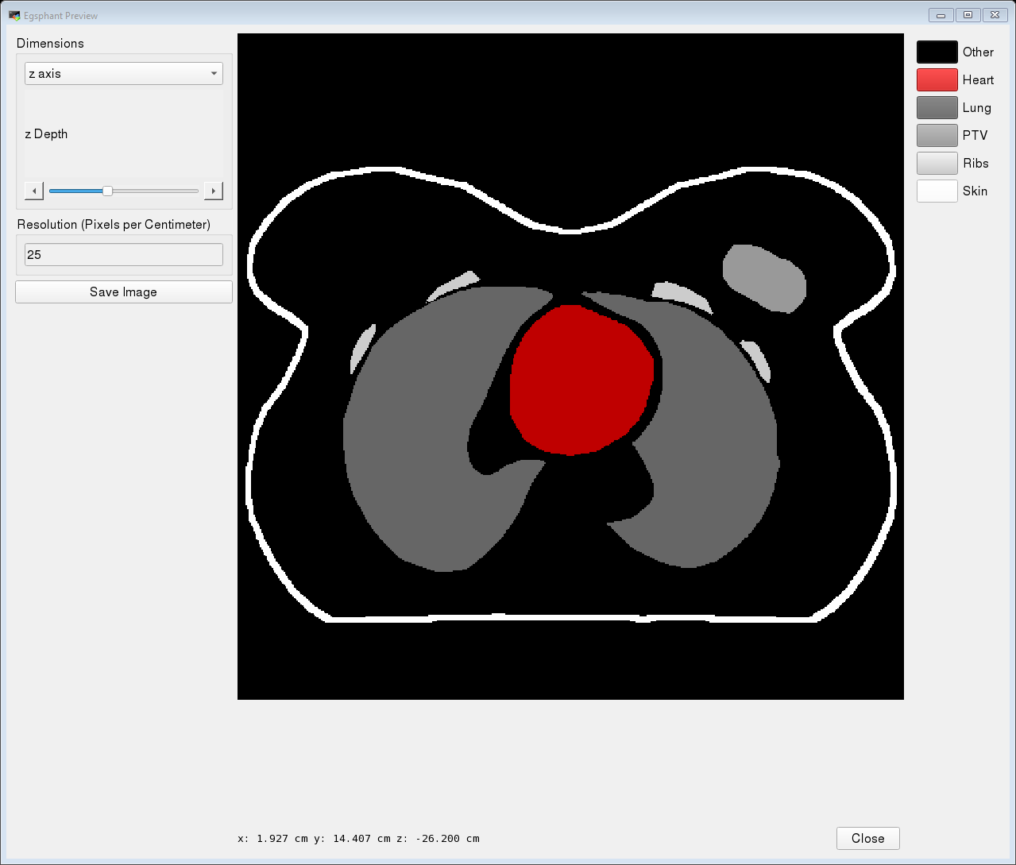
Physician Drawn Organ Contours

Slide 15
2) Create a patient model
Process begins with an empty patient model
Each voxel has a corresponding pixel value
Pixel value (HU) is converted to density
Number of voxels is based on the number and size of CT images
Using the CT machine specific conversion
Each voxel is mapped to an organ using the physician drawn contours
A tissue assignment scheme determines the tissue of each voxel

Slide 16
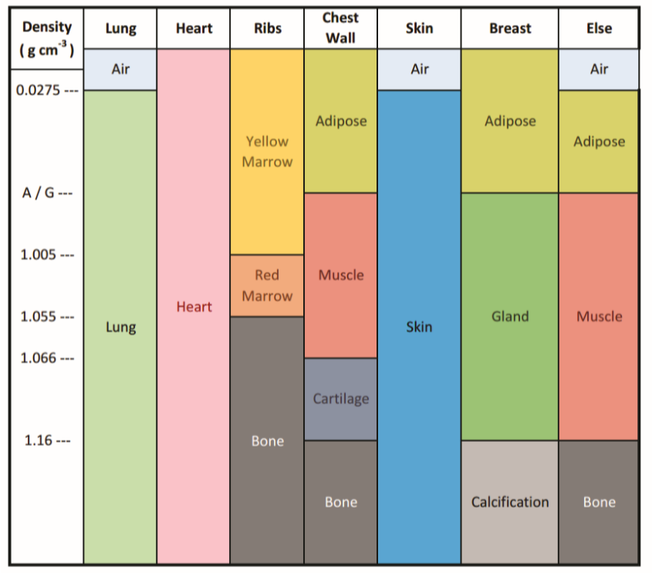
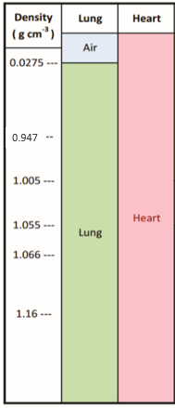
Breast Tissue Assignment Scheme
Organs in the patient
0.947
Tissues
Deering, S. (2017). Monte Carlo Dose Calculations for Permanent Breast Seed Implant Brachytherapy (Master's thesis).
Retrieved from https://curve.carleton.ca/450b147b-d385-47a3-8f12-c0a479f2ece7 (p 21) [Modified]
Notes:
Top identifies the contours in the patient

Slide 17
3) Create egs_brachy input files
The input files contain:
Patient model
Parameters to run the simulation
Location and type of brachytherapy source

Slide 18
4) Launch egs_brachy
Monte Carlo code
Models radiation transport and energy deposition
Calculates the dose and error delivered to each voxel

Slide 19
5) Convert egs_brachy output to clinical format
Data converted to the DICOM format
Can be read by clinicians
Dose metrics are calculated
Helps to evaluate the treatment plan

Slide 20
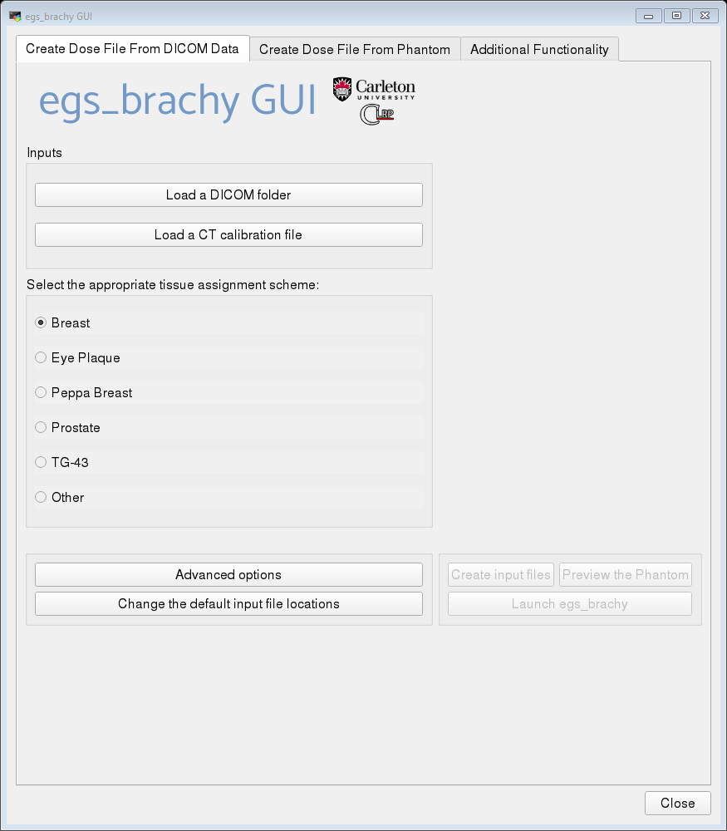
Screenshot of egs_brachy GUI
1

Slide 21
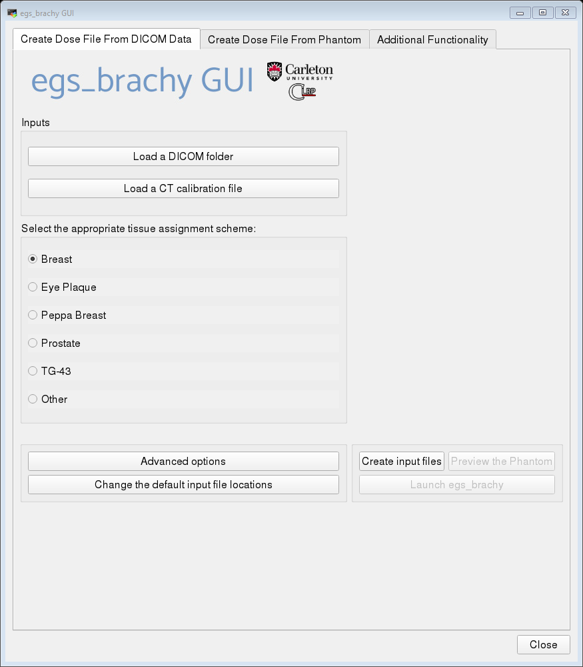
Screenshot of egs_brachy GUI
2

Slide 22
Screenshot of egs_brachy GUI
3

Slide 23
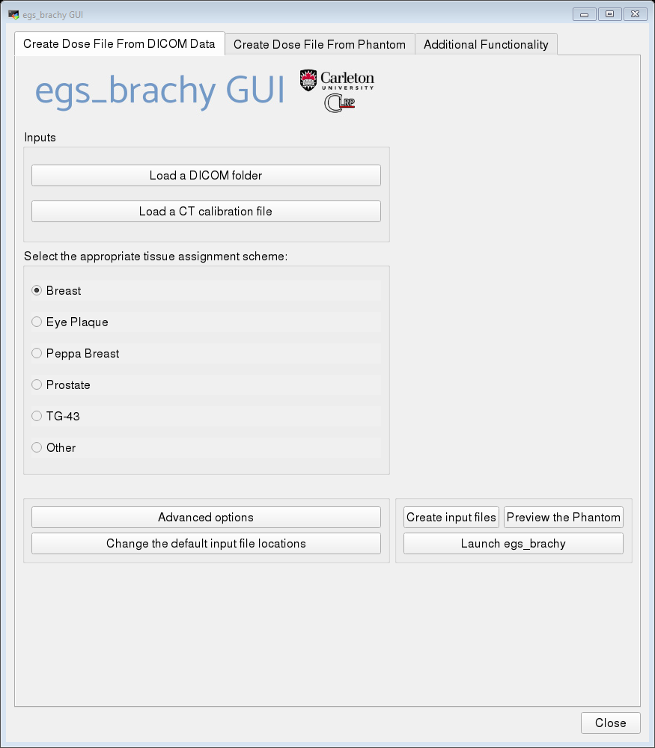
Screenshot of egs_brachy GUI
4

Slide 24
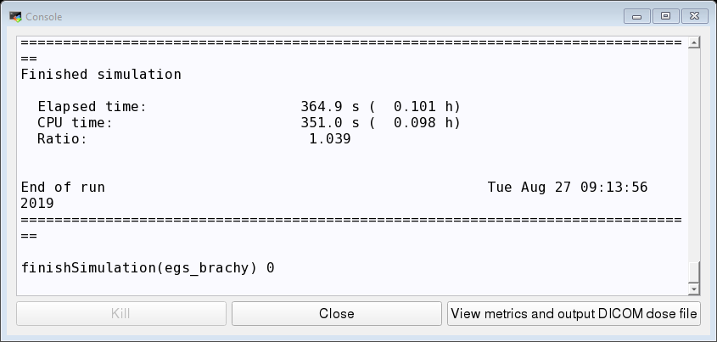
Screenshot of egs_brachy GUI
After egs_brachy has finished running
5

Slide 25
Thank you

Slide 26
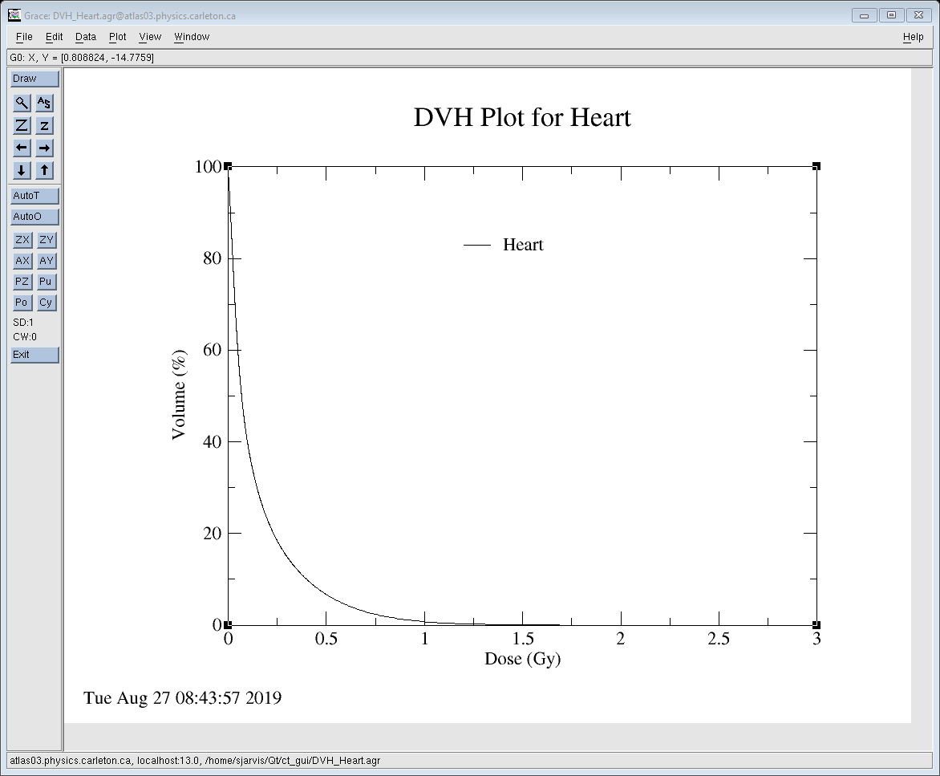
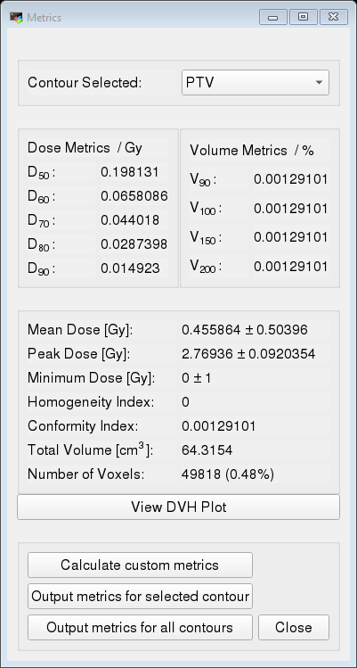

Slide 27
What I Learned
C++ and Qt
Using linux
Introduction to medical physics
And much more!

